Slide 1
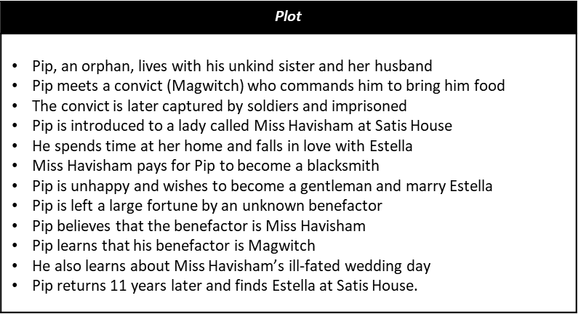
Great Expectations Context
The Victorian Era: the period of Queen Victoria's reign, from 20 June 1837 until her death on 22 January 1901. Despite the fact that Britain was seen as a strong global power, this era saw a large amount of social inequality. There was also a lot of change during this era as it saw the advancement of technology and industry with the Industrial Revolution. Charles Dickens wanted to show how difficult growing up was in these times, as well as reveal the differences in the lives of the rich and the poor.
Social class: In Victorian times, society was strictly layered - not only into rich and poor, or even upper, middle and lower class, but hundreds of 'grades'. People were expected to 'know their place', and the Church taught them to be content in their 'station'. There was a huge gap between the rich and poor; the poor were very poor and the rich did little to help the poor or alleviate their situation
Social problems: At the time, many people were becoming aware of the need to improve the condition in which the poor found themselves. Dickens was a great supporter of social reform - especially in education and prisons.
Charles Dickens: Dickens was born in England in 1812. He died in 1870. Dickens lived through the Industrial Revolution. When he was 12, his father was imprisoned for debt. While his father was in prison, Dickens was sent to work in a boot-blacking factory. Even when his father came out of prison, Dickens' mother made him continue working in the factory - for which he never forgave her.
Nineteenth century literary traditions: By 1860, although most people in Britain could read and write, books were well beyond the income of ordinary people. Because of this, Dickens' novels were serialised. Great Expectations was published in 36 weekly parts in All Year Round, priced 2d (two pence in old money).
Key Characters
Pip | The hero, protagonist and narrator of Great Expectations who starts as an orphan and receives a large and unexpected fortune. (victimised, lonely, naïve)
Magwitch | A fearsome criminal, Magwitch escapes from prison at the beginning of Great Expectations and later becomes Pip’s secret sponsor. (rough, complicated, generous)
Estella | Miss Havisham’s beautiful adopted daughter, Estella is Pip’s unachievable dream throughout the story (beautiful, arrogant, cold)
Miss Havisham | The old woman who lives in Satis House. As a young woman, Miss Havisham was deserted by her fiancé minutes before her wedding, and now she hates all men. (bitter, manipulative, vengeful)
Subject Terminology
Exposition: a detailed explanation of characters and their backgrounds at the beginning of a text
Benefactor: a sponsor
Grotesque: focuses on the human body, and all the ways that it can be distorted or exaggerated: its aim is to make us feel both empathy and disgust at the same time.
Bildungsroman: a coming of age novel which focuses on the development of the protagonist from youth to adulthood
Patriarchal: relating to a system/ society where men dominate
Protagonist: the leading character in the novel
Social Class: a section of society based on social and economic background
Narrative Perspective: the point of view from which the story is told. In the case of Great Expectations, Pip is the narrator so there is a ‘First Person Narrative’
Serialisation: when stories were released in a series of weekly instalments instead of as a whole novel – they were serialised.

Slide 2
Why is the genre of a Bildungsroman novel significant?
Pip is both the narrator of Great Expectations and its protagonist. His perspective both determines what we see and how we see it. The novel follows Pip from the age of about eight to his mid-thirties and qualifies as a bildungsroman. Great Expectations is divided into three parts corresponding to the phases of Pip's life. The first stage covers his childhood, during which he is 'brought up by hand' by his older sister, his parents having died. The second covers his apprenticeship in London, from his mid-teens to his coming of age, at which time he also comes into his mysterious inheritance, of which he has such great expectations (hence the novel's name). The third part of the novel shows Pip getting a better grip on who he is and who he wants to be, from his mid-twenties to his mid-thirties. It also covers how those 'great expectations' are - and are not - fulfilled. As Pip is our narrator, the reader lives Pip's life with him, and we see: the way contact with rich people makes him dissatisfied how coming into money makes him shallow and selfish, and unhappy how trying to find love with a beautiful, yet cruel, girl makes him unhappy - the plain, good girl would have been better how disappointments change his character for the better how Pip is happier when he settles down to a decent living through hard work - this is one of the main messages of the novel
Key themes
SOCIAL CLASSES: There was a big divide between the upper class and lower class people in the Victorian era. Dickens did not like the effects of social class. Pip sees that many of the people of 'high' social class have significant character flaws, and that people from other social classes are 'better' human beings. On the other hand, violent and surly lower working class people are to be feared and distrusted. Dickens' message is that the middle class values of godliness, hard work and the gentleness of a 'gentleman' are - with sufficient income - the way to happiness. This message would appeal to his middle class/upper working class readers.
CRIME AND THE LAW: Dickens had a social conscience and was deeply critical of the existing system of law and justice. (Remember that his father was imprisoned for debt.) Issues relating to crime and the law run throughout Great Expectations. For example: The story starts with Pip meeting a 'fearful' criminal in a cemetery, who makes him steal a file and food. Dickens' shocking conclusion is that, in Victorian England, some criminals were good men trapped by an unfair system; that punishment missed the guilty; that lawyers were rotters; and that prison was an inhumane place - in short, that England's system of justice was wholly unjust.
AMBITION AND SELF-IMPROVEMENT: In 1859, Samuel Smiles published his book Self-Help, which told people that if they worked hard they could improve their station in life. The 19th century was the age of the 'self-made man'. Most of Dickens' readers would have wanted to better themselves: Dickens' message is that 'character' is not about money or class, but what is in your heart. The true heroes are Biddy and Joe. Dickens felt that ambition does not necessarily bring success. What matters to Dickens is not what you achieve, but what kind of person you are.
LOVE AND DECEPTION: Dickens explores love and loyalty in Great Expectations. He makes it clear that they underlie happiness and misery. For example, Pip’s unrequited love for Estella throughout the novel only brings misery for Pip. Miss Havisham’s life is ruined when she is jilted on her wedding day.
Techniques | Examples
Simile: describing something by comparing it to something else (it must use ‘like’ or ‘as’) | ‘So she sat, corpse-like, as we played at cards’
Metaphor: describing something by saying it is something else | ‘He put down his head, blew a cloud of smoke out of his nose, and vanished with a kick-up’
Imagery: a technique in which the author appeals to the senses i.e. seeing, hearing, touching. | ‘It was a rimy morning, and very damp. I had seen the damp lying on the outside of my little window, as if some goblin had been crying there all night.’
Personification: describing an inanimate object as having human feelings. | ‘One black ox, with a white cravat on - who even had to my awakened conscience something of a clerical air - fixed me so obstinately with his eyes, and moved his blunt head round in such an accusatory manner’
Listing: when the writer includes several words/ phrases/ ideas, one after the other. | ‘A man…who limped, and shivered, and glared and growled.’
Repetition: when a word/ phrase is noticeably repeated throughout a sentence/ paragraph/ whole text. | ‘The shoe upon it, once white, now yellow, had never been worn…. the silk stocking on it, once white, now yellow, had been trodden ragged.’
Semantic field: a set of words that are related in meaning | She looked at Sarah Pocket with triumph in her weird eyes, and so I left my fairy godmother, with both her hands on her crutch stick, standing in the midst of the dimly lighted room beside the rotten bridecake that was hidden in cobwebs.
Motif: a repeated image that helps to convey a theme | ‘Saw her running at me, shrieking, with a whirl of fire blazing all about her….she had been in flames…every vestige of her vest was burnt’

