Slide 1

Year 10
Information & Guidance Evening
Welcome

Slide 2

Year 10
Information, Advice & Guidance Evening
  Welcome
  Key People
  Our Purpose
  Expectations
  Support
  Keeping you informed
  How to access support
  Attendance
  Key Dates

Slide 3
Key People
  Mrs Wagstaff– Head of Year 10
  Mrs Williams– Pastoral Manager
  Mrs Feast – Raising Standards
  Form Tutors
  Teachers
  Pastoral Team

Slide 4

Our purpose

Slide 5
IT’S NEVER TOO EARLY TO START REVISION…

Slide 6
More challenge and higher expectations
GCSEs are more challenging and require students to demonstrate far more knowledge and understanding as well as increased breadth
Subjects assessed at end of Y11, more exam papers
Coursework has gone from almost all subjects (some practical-based subjects remain)
A-levels have increased in challenge too
From 2018, a Grade 4 is considered a ‘standard pass’, and a Grade 5 a ‘strong pass’.
Students who do not achieve a Grade 4 or above in English Language and Maths must continue to study in Sixth Form/College and ‘resit’

Slide 7
Expectations for success
Work ethic
Resilience- strive for excellence
Independent study/homework
Assessments – formative/summative
Excellent attendance
Taking advantage of everything offered

Slide 8
Support for them

Slide 9
Support for them
GCSEPod
PLC’s/Knowledge Organisers
Instagram/School Website/Email

Slide 10


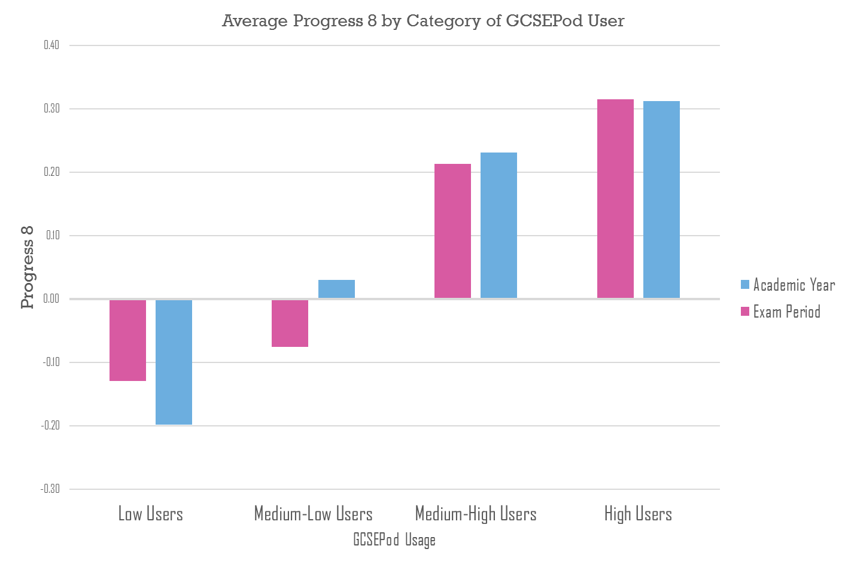
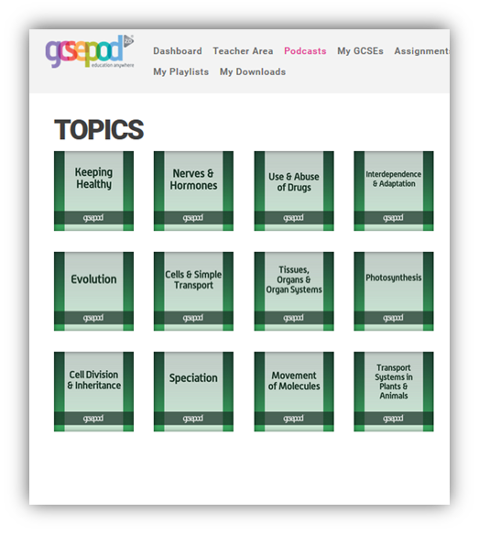


What is GCSEPod?
GCSEPod provides highly concentrated 3-5 minute bursts of audio-visual, expert-written learning which can help to reinforce and consolidate key GCSE topics covered in lessons.

Slide 11

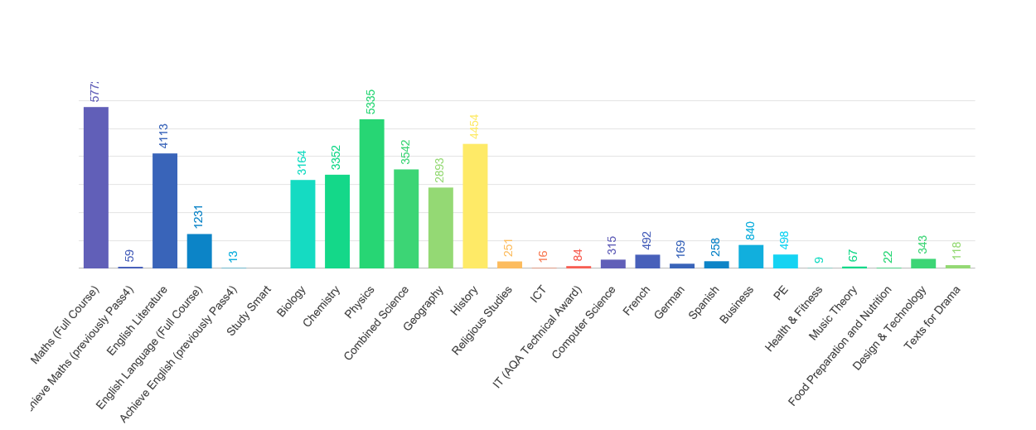

37,410 Pods watched last year

Slide 12
So, how do you use GCSEPod?

Slide 13
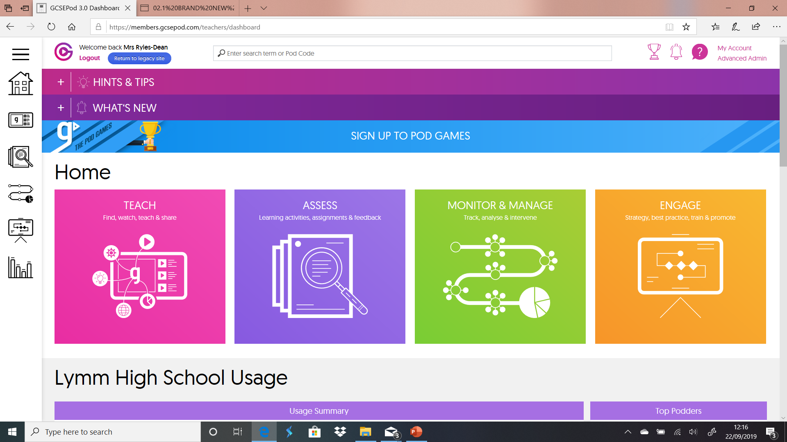

Slide 14
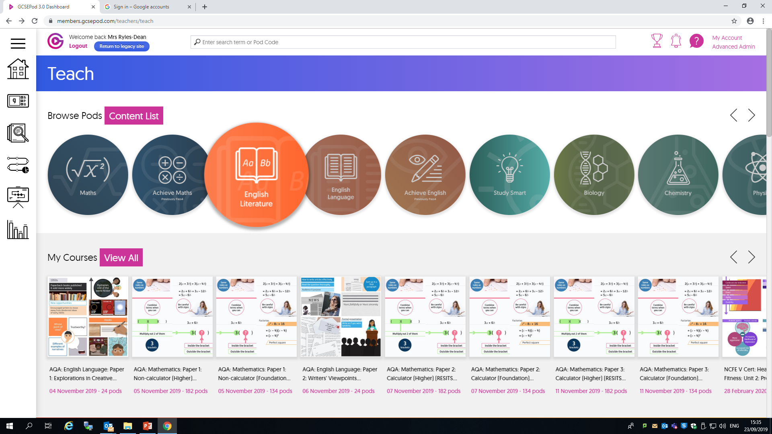

Slide 15
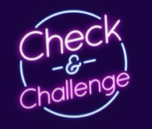
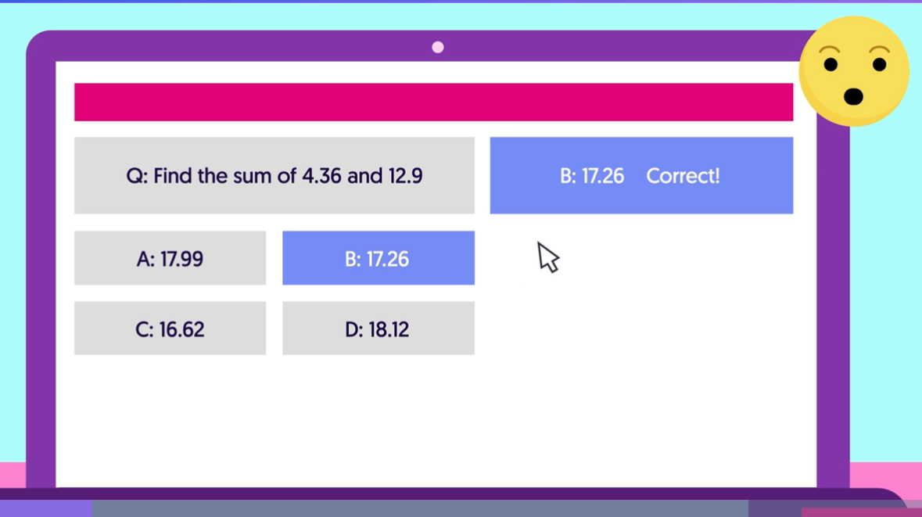
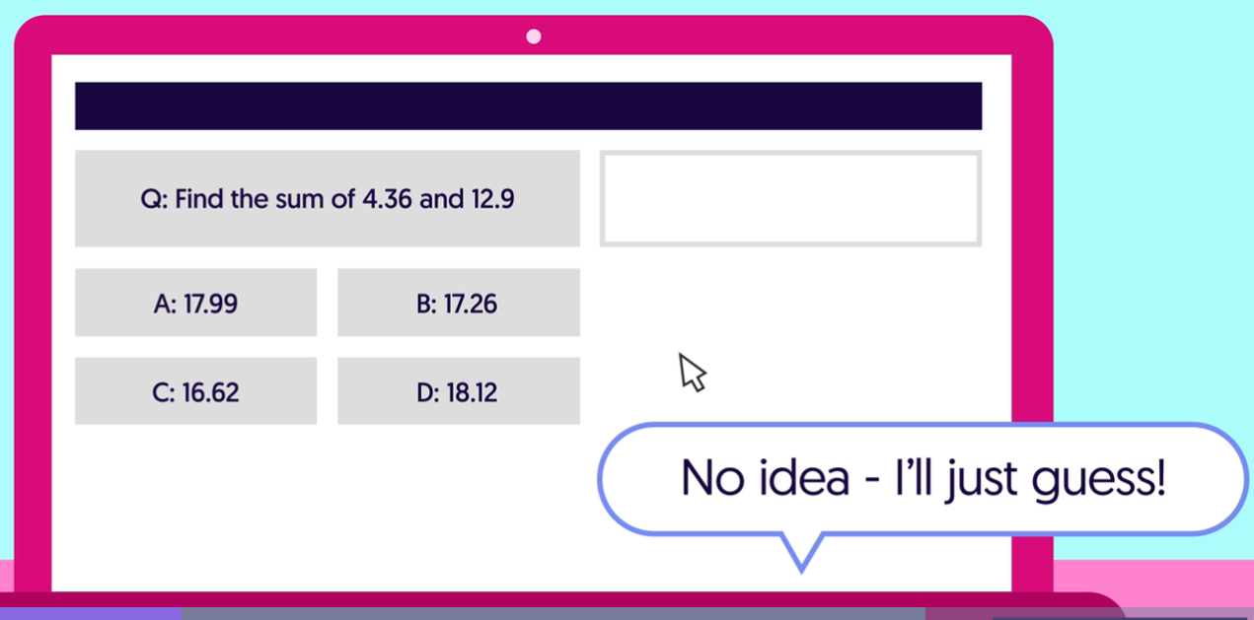

Slide 16
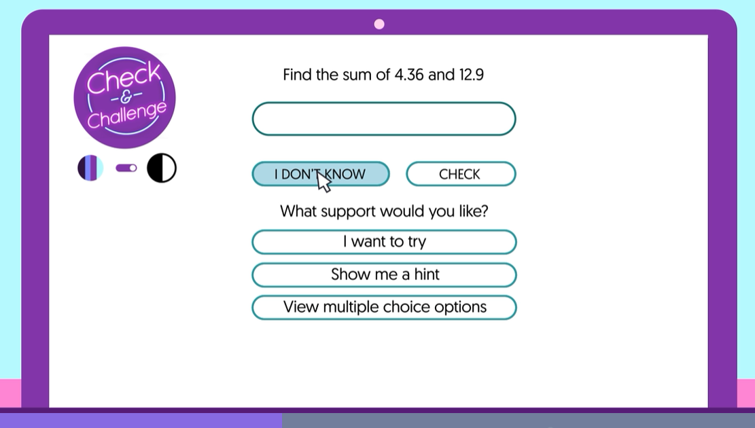
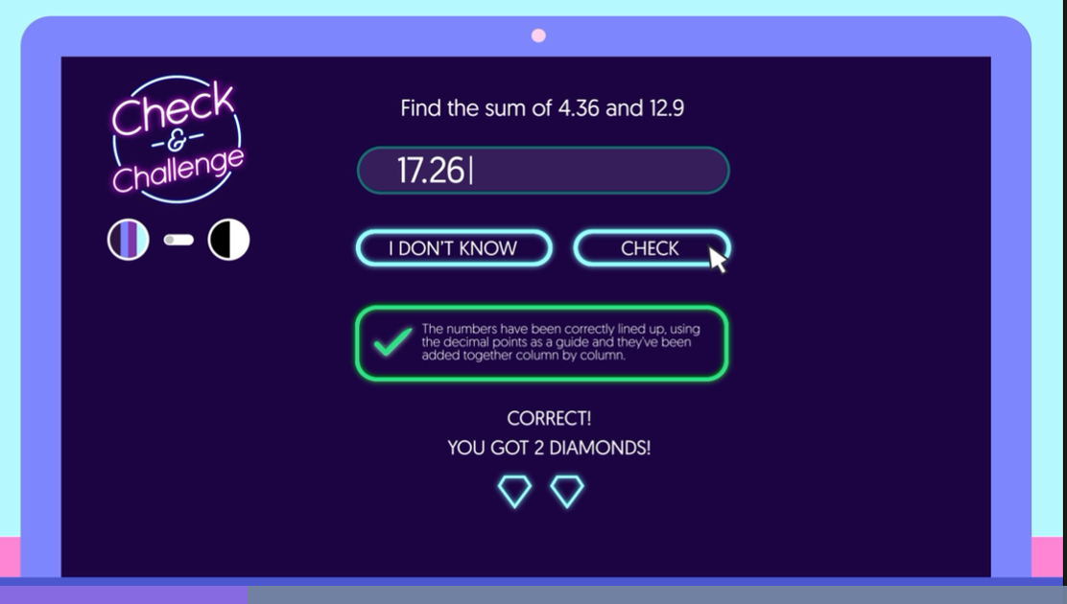
Check and Challenge

Slide 17
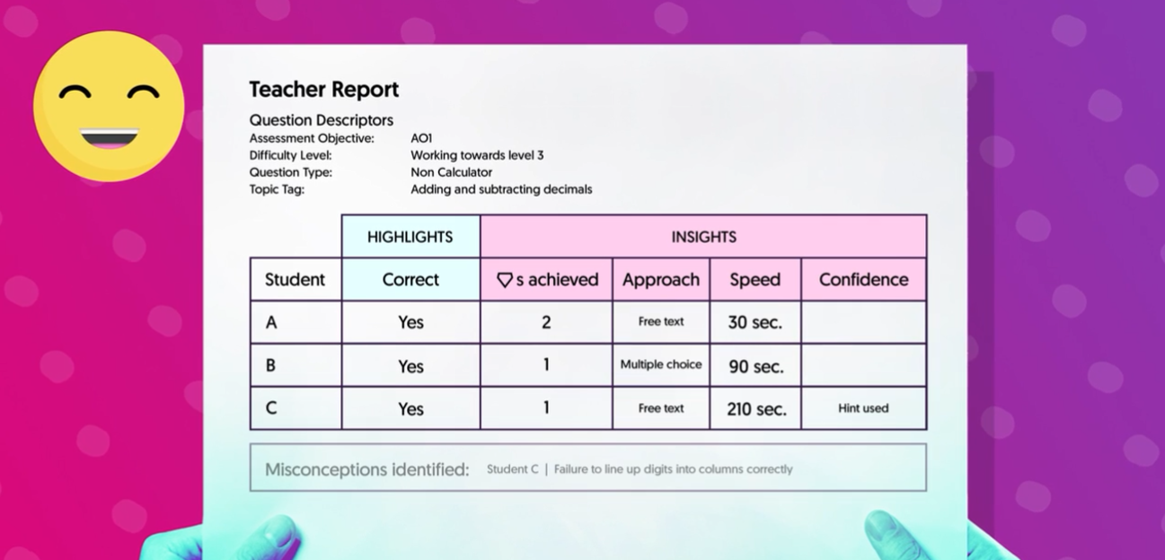

Slide 18

Watching a GCSEPod video combines seeing, doing and listening
Break out of your comfort zone with Active Learning

Slide 19
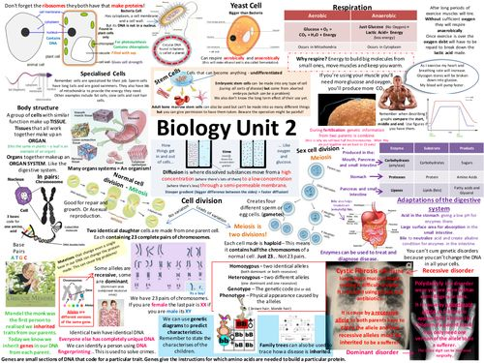
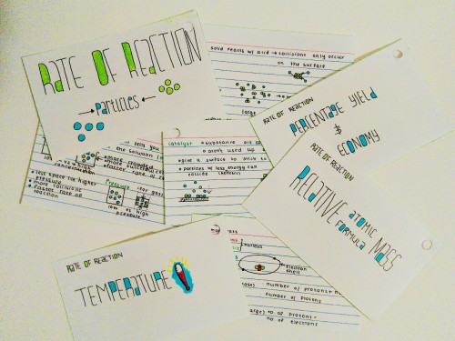
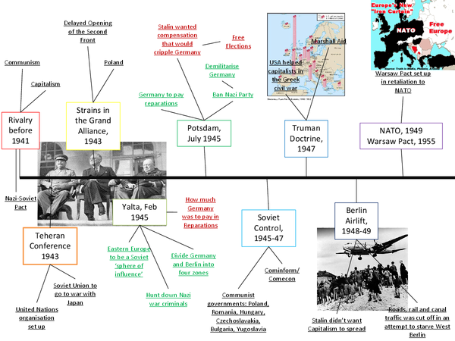

Once you have watched a Pod…
try some of these ways to revise
Mind Mapping
Flash Cards
Create a Quiz
Create Timelines
Summary Posters
Past Papers
Mnemonics

Slide 20



1.
Go to: https://members.gcsepod.com
2.
Click New Here? Get Started!
3.
Enter your email address
4.
Check your email address for a password and then log in

Slide 21



GCSEPod

Slide 22









Revision Guides and Work Books
Revision Guides are a really useful tool for students. We do have copies in school and some departments sell them direct to the students.
On the school website, under ‘Revision Support’, all the guides that staff recommend for their subjects are listed.

Slide 23
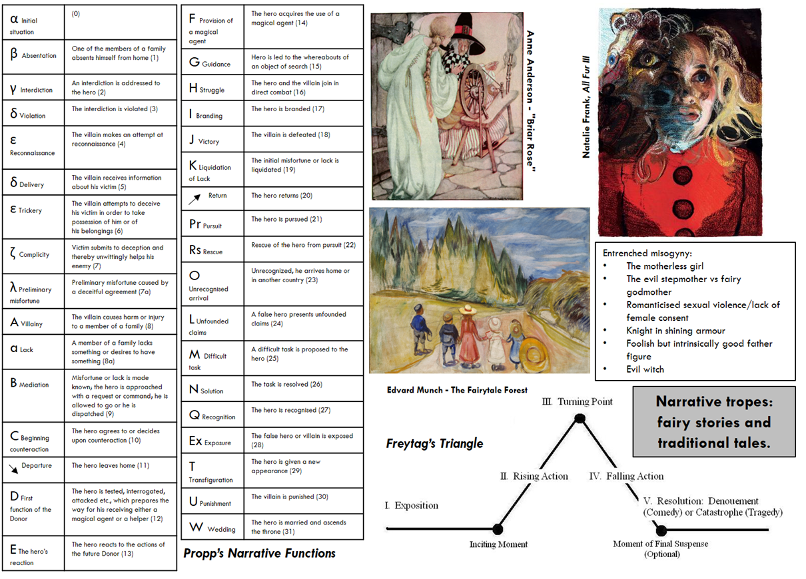
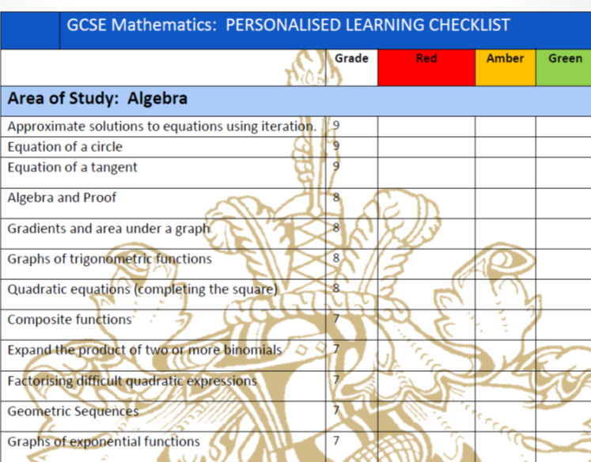
Personalised Check Lists/Knowledge Organisers

Slide 24

Private Tutors
Be careful – they are very variable in quality.
Please make sure you go with the school view if there is something that contradicts the school.
Tutors are not a substitute for revision.

Slide 25
Keeping you informed how they are progressing?
Progress Reports across the year
Parents Evening – 11th March 2021
Mock Exams –June 2021
Mock Results Day –July 2021

Slide 26
Pastoral Support for you
Student Services
Mrs Wagstaff
Gateway App
School Website – Parent Comms.
All support can be accessed by contacting Student Services on
01925 750711 and asking for the relevant person.

Slide 27
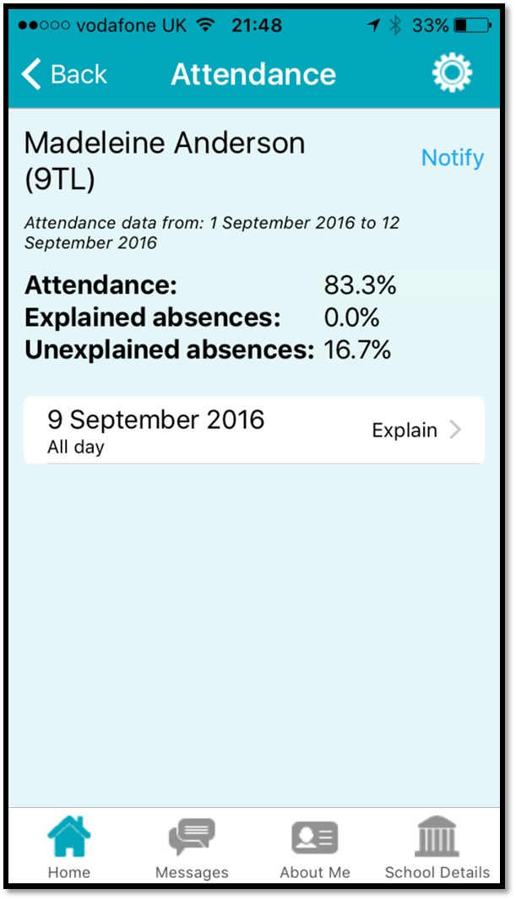
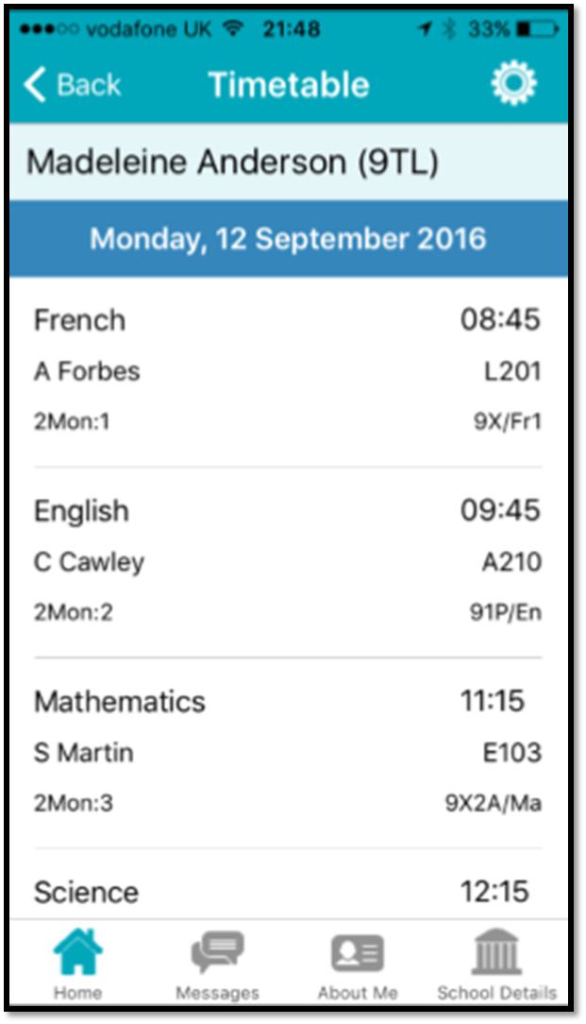
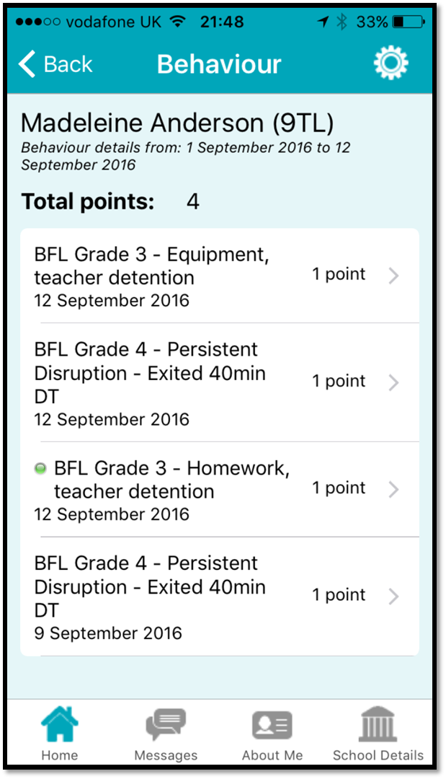
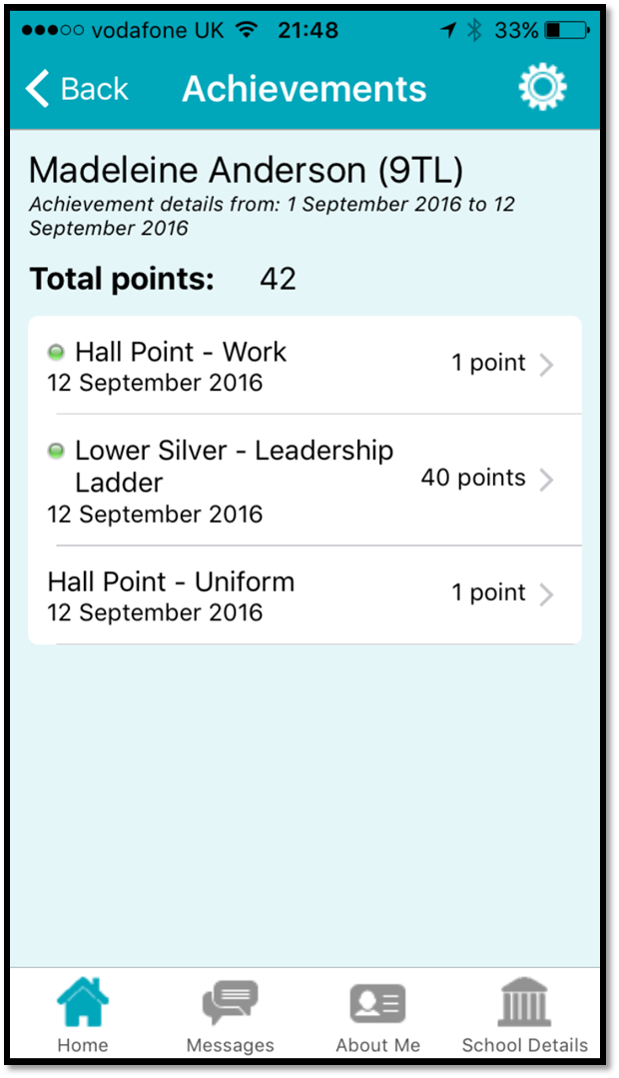
Support for you
Gateway App

Slide 28
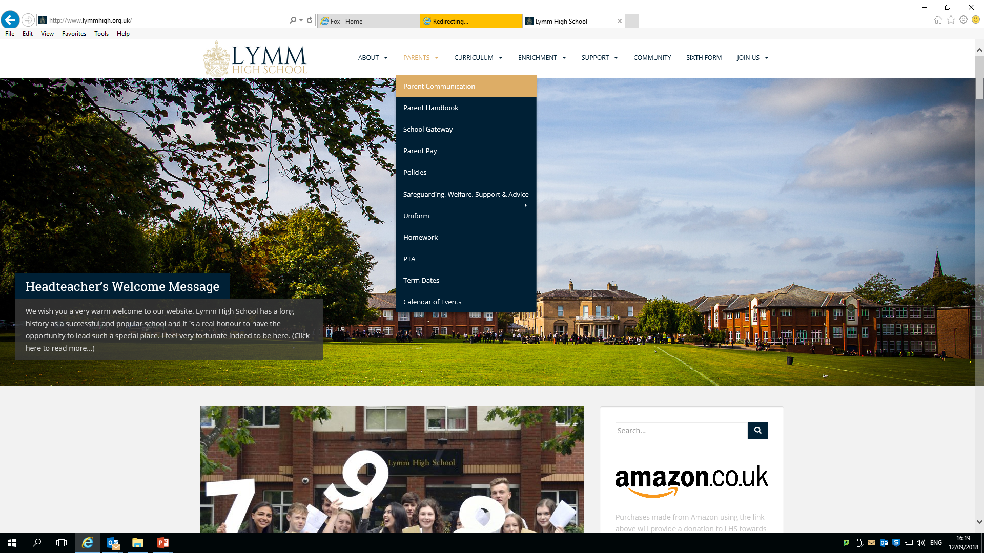
Support for you
School Website – Parent Communication.

Slide 29
Academic Support for you
Subject Teacher
Head of Subject/Head of Faculty
Mrs Feast
Helping your child revise events
Parents Evening
All support can be accessed by contacting Student Services on
01925 750711 and asking for the relevant person.

Slide 30

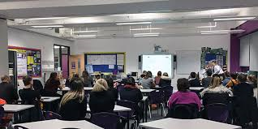


Support for you
Helping your child revise sessions
Parents Evening

Slide 31
Ensuring Success
Punctuality & Attendance
Avoiding distractions
Dress smart/think smart - uniform

Slide 32
Ensuring Success
“Your child’s attendance in Year 7 to 11 has a direct impact on their GCSE results”
All students should be aiming for 97% attendance or higher
By missing lessons as a result of low attendance, a student will:
Miss being taught new subject knowledge
Miss recapping subject knowledge to make sure they 'get it‘
Miss key tests and assessments to test what they do and don't know
Start to fall behind their peers and reduce their chances of achieving well in their GCSEs
Struggle to make the transition between years because they won't have secured all subject knowledge from the year before

Slide 33
Ensuring Success
Punctuality & Attendance
 | > 85% attendance (during 4-week exam period) | < 85% attendance (during 4-week exam period)
Positive P8 score | 77% | 49%
Average P8 | 0.69 | 0.04
Average A8 | 60 | 51
5+ 9-7 grades | 41% | 23%

Slide 34
Ensuring Success
Punctuality & Attendance
 | Approx. hours of lessons missed by end of each half-term
Attendance | Half-term 1 | Half-term 2 | Half-term 3 | Half-term 4 | Half-term 5 | Half-term 6
95% | 10 hrs | 20 hrs | 27 hrs | 35 hrs | 40 hrs | 50 hrs
90% | 17 hrs | 35 hrs | 52 hrs | 67 hrs | 80 hrs | 95 hrs
85% | 25 hrs | 55 hrs | 80 hrs | 100 hrs | 118 hrs | 145 hrs
80% | 33 hrs | 73 hrs | 105 hrs | 135 hrs | 158 hrs | 193 hrs
75% | 40 hrs | 90 hrs | 130 hrs | 168 hrs | 195 hrs | 240 hrs
70% | 50 hrs | 107 hrs | 155 hrs | 200 hrs | 235 hrs | 288 hrs
65% | 58 hrs | 125 hrs | 182 hrs | 235 hrs | 275 hrs | 335 hrs
60% | 65 hrs | 145 hrs | 208 hrs | 268 hrs | 315 hrs | 385 hrs

Slide 35

“Strive for excellence and success
will follow”
Thank you and have a safe journey home

