Slide 1

Year 11
Information & Guidance Evening
Welcome

Slide 2

Year 11
Information, Advice & Guidance Evening
  Welcome
  Our Purpose
  The next ten months
  Expectations
  Keeping you informed
  Support for them
  Support for you
  Ensuring Success
  Planning for a future

Slide 3
Key People
  Miss Taylor– Head of Year 11
  Miss Brown– Pastoral Manager
  Mrs Feast – Raising Achievement
  Form Tutors
  Teachers
  Wider Pastoral Team

Slide 4

Lost learning
Online engagement during lockdown
New term, fresh start
Additional classes maths, science
Holiday ‘catch up’
Revision programme
Frequent low stakes testing
Tassomai/GCSE Pod
Mock exams
Guided intervention

Slide 5
Our purpose

Slide 6
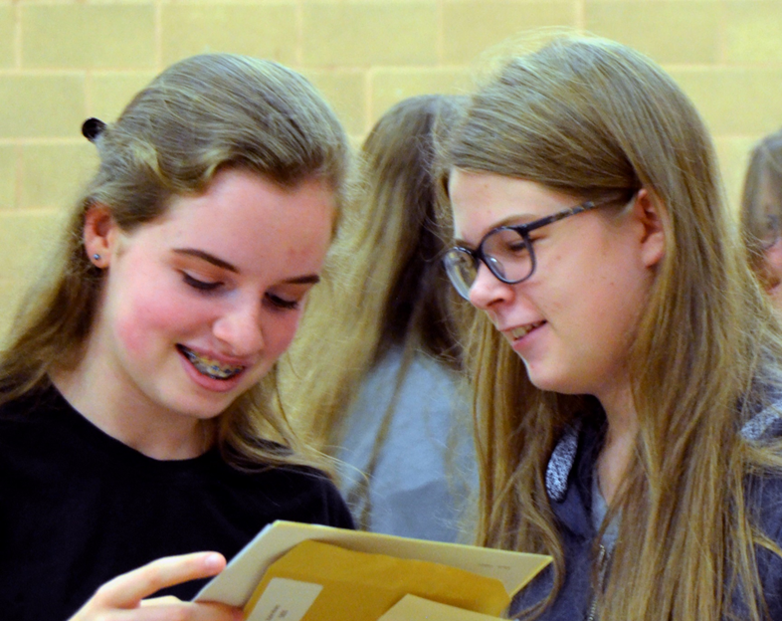
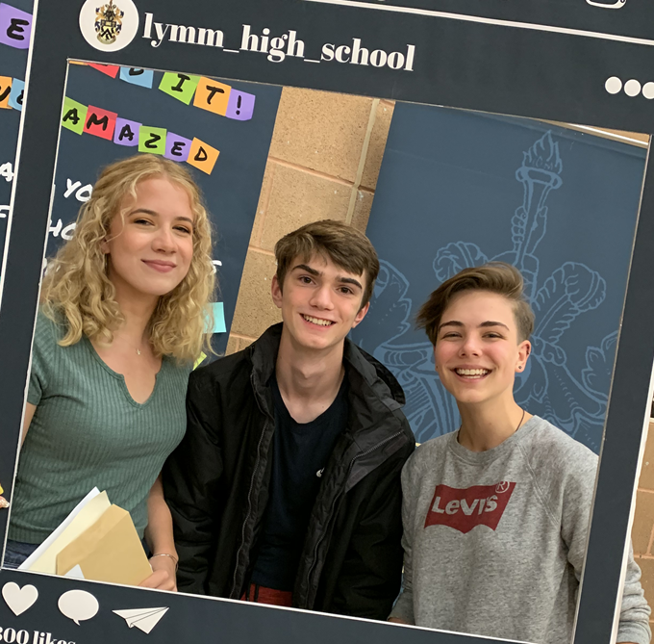
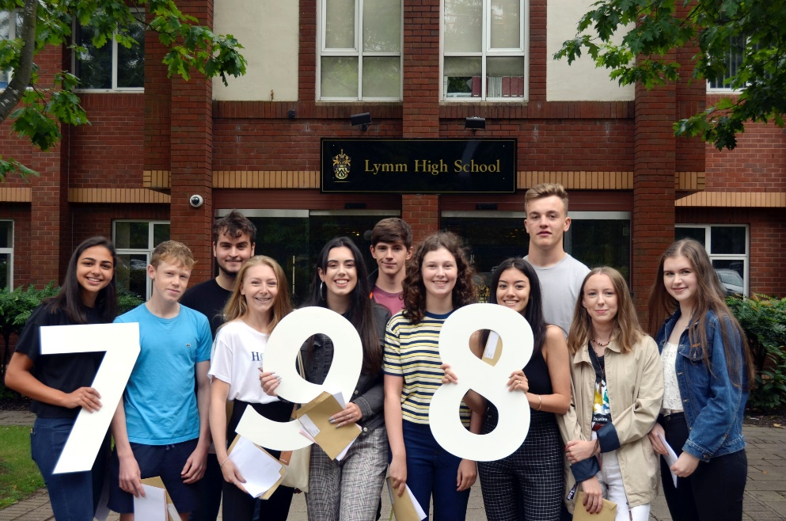
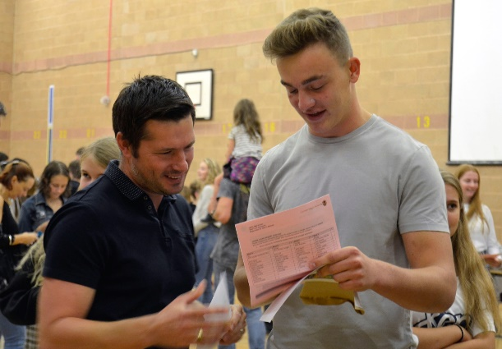
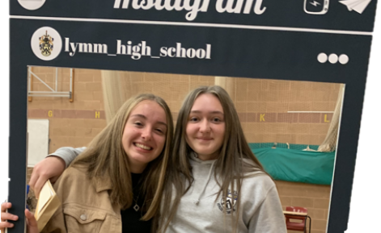



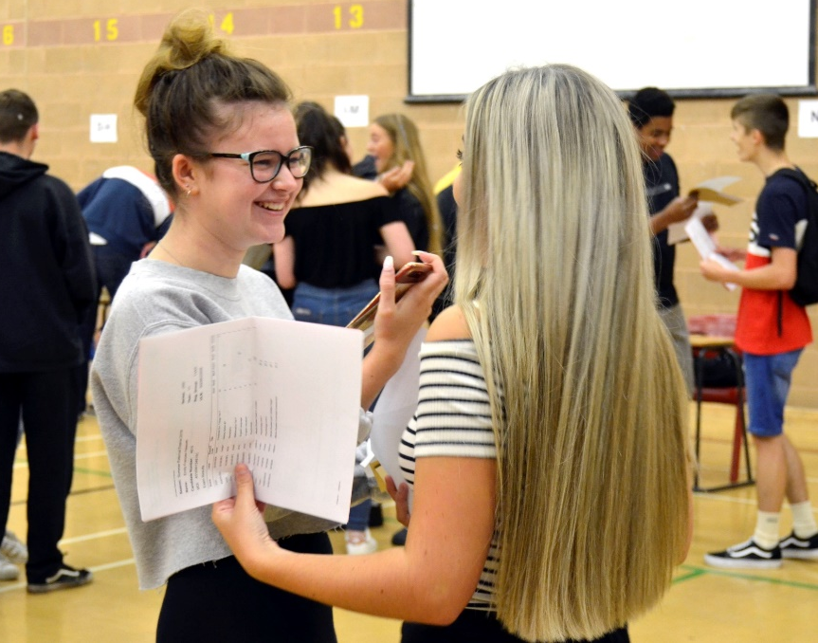
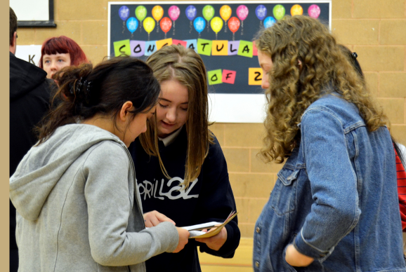
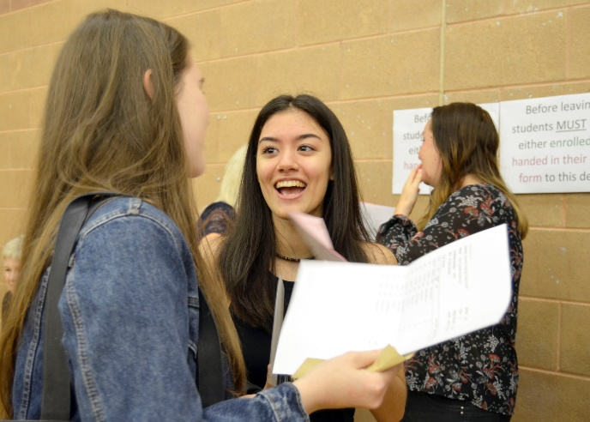
Our purpose

Slide 7
The next 10 months
Character development
Building resilience
Encouraging hard work
Striving for achievement/success
Having a love of learning
Preparing for next steps

Slide 8
150 school days left… less than half a year!
This takes us to the middle of June…

Slide 9
Expectations for success
Work ethic
Resilience- strive for excellence
Independent study/homework
Assessments – formative/summative
Excellent attendance
Taking advantage of everything offered
Working with us

Slide 10
Keeping you informed how they are progressing?
Progress Reports across the year
Parents Evening – 8th October
6th Form Open Evening- 12th November
Mock Exams – 7th - 18th December
Mock Results Day – 18th January
Core Mocks – 1st – 5th March

Slide 11
Support for them

Slide 12
Support for them
GCSEPod
Tassomai
Guided revision sessions
Study Skill Sessions/Mindfulness Sessions
PLC’s/Knowledge Organisers
Form Tutors/Student Services/Teachers
Instagram/School Website/Email
Form time- careers and aspirations

Slide 13


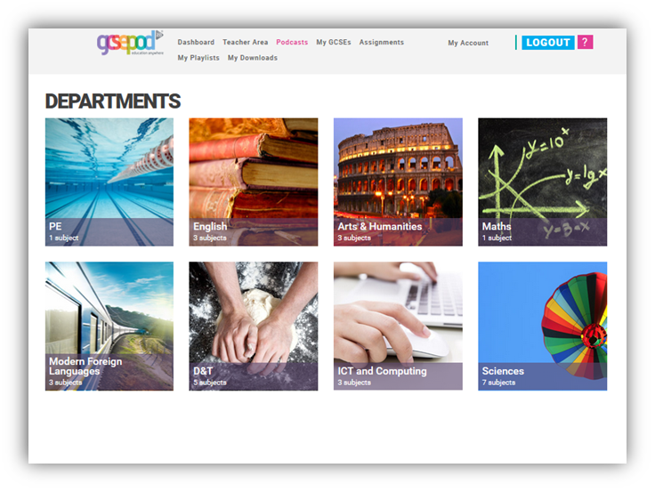
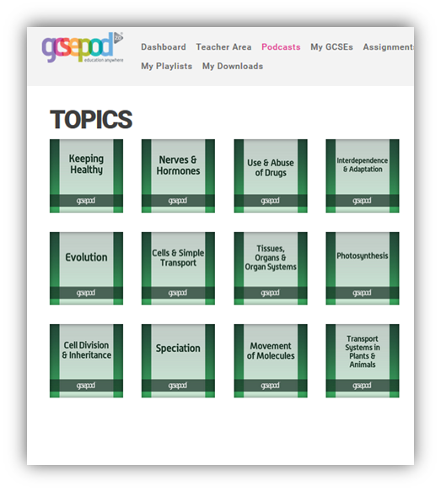
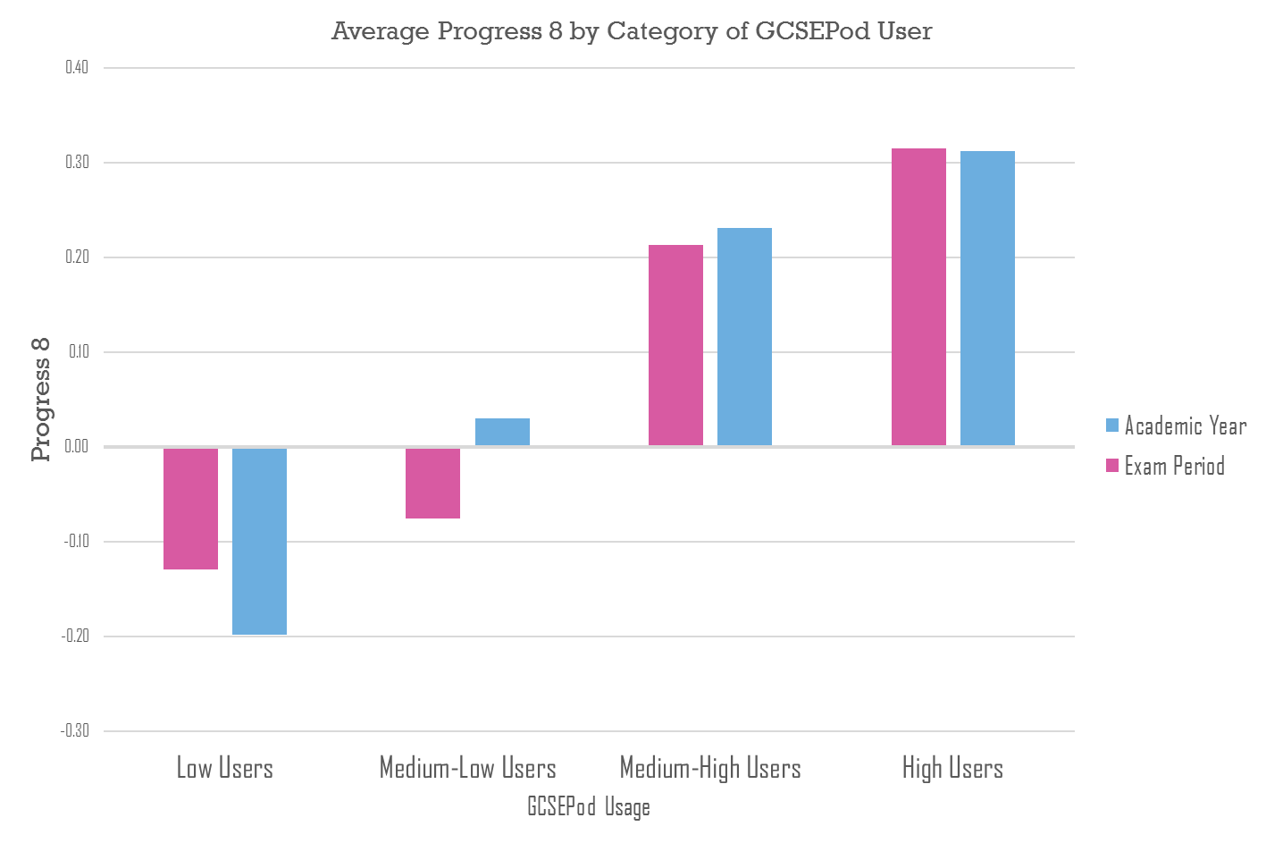
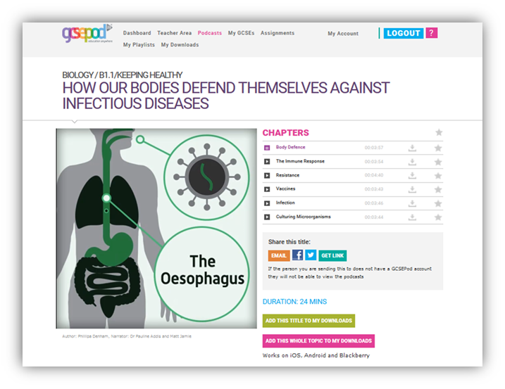
GCSEPod

Slide 14
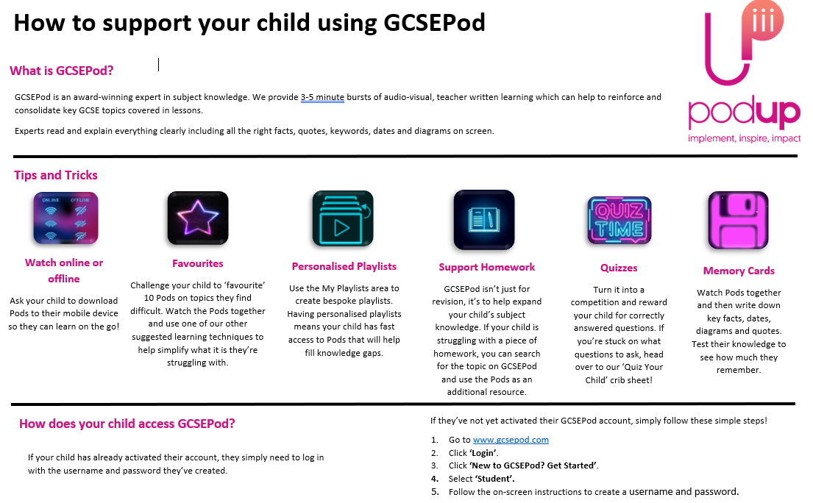
GCSEPod

Slide 15



GCSEPod

Slide 16

Low-stakes testing, drilling core knowledge
Used to avoid stressful cramming near exams by spreading learning and revision throughout the year.
Students who used Tassomai regularly achieved outstanding results in their GCSE science exams. 88% of students who used Tassomai regularly achieved higher grades
Use on phone, tablet or computer
15 mins per day of quizzing

Slide 17
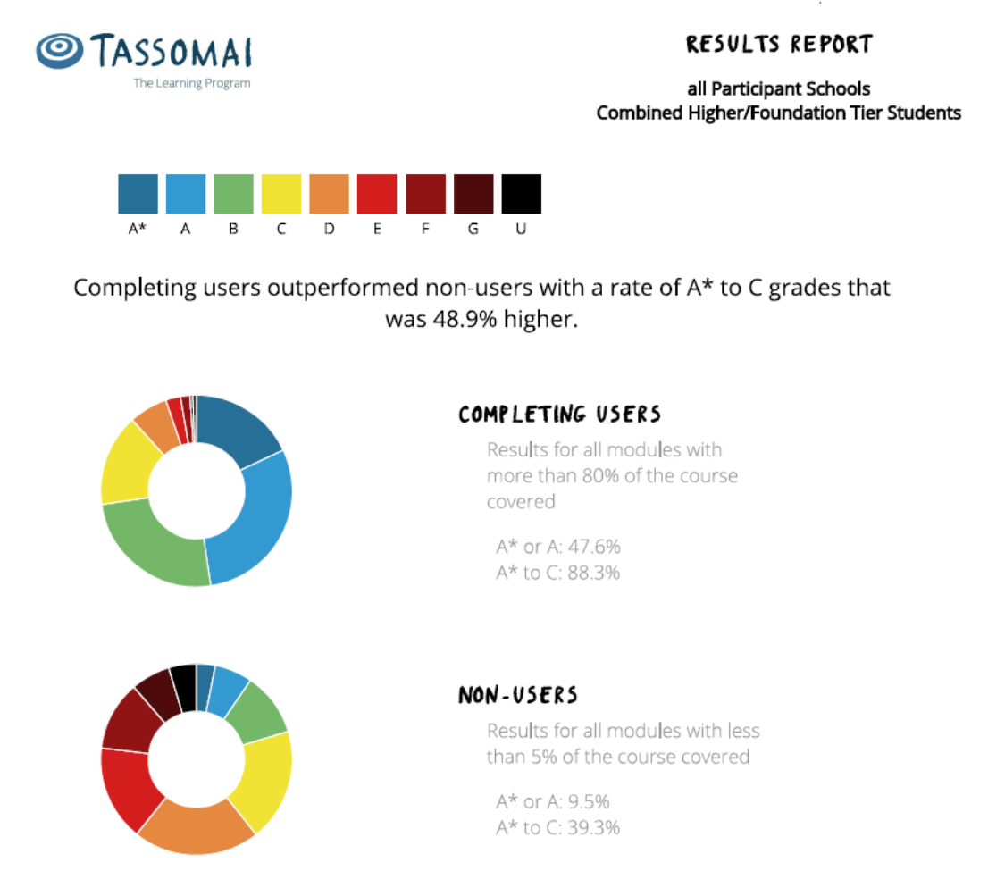
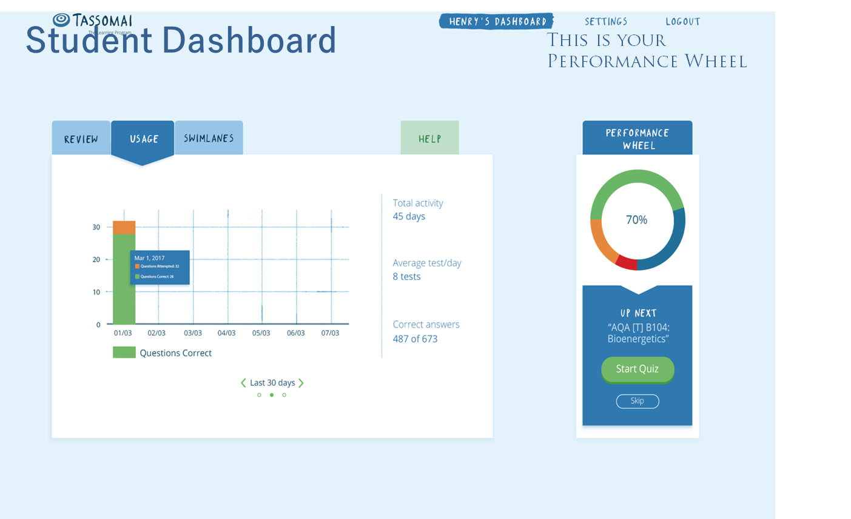

Slide 18

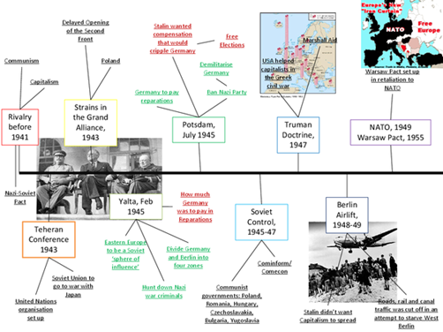
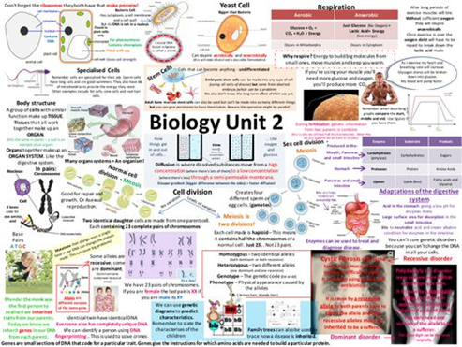

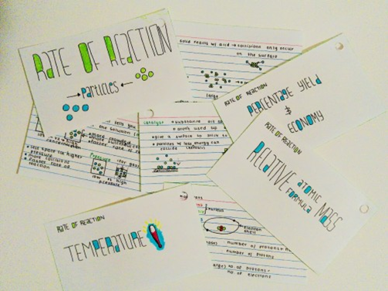

Revision Rooms
Revision Sessions
Study Skill Sessions
Mindfulness Sessions

Slide 19









Revision Guides and Work Books
Revision Guides are a really useful tool for students. We do have copies in school and some departments sell them direct to the students.
On the school website, under ‘Revision Support’, all the guides that staff recommend for their subjects are listed.

Slide 20

Private Tutors
Be careful – they are very variable in quality.
Please make sure you go with the school view if there is something that contradicts the school.
Tutors are not a substitute for revision.

Slide 21
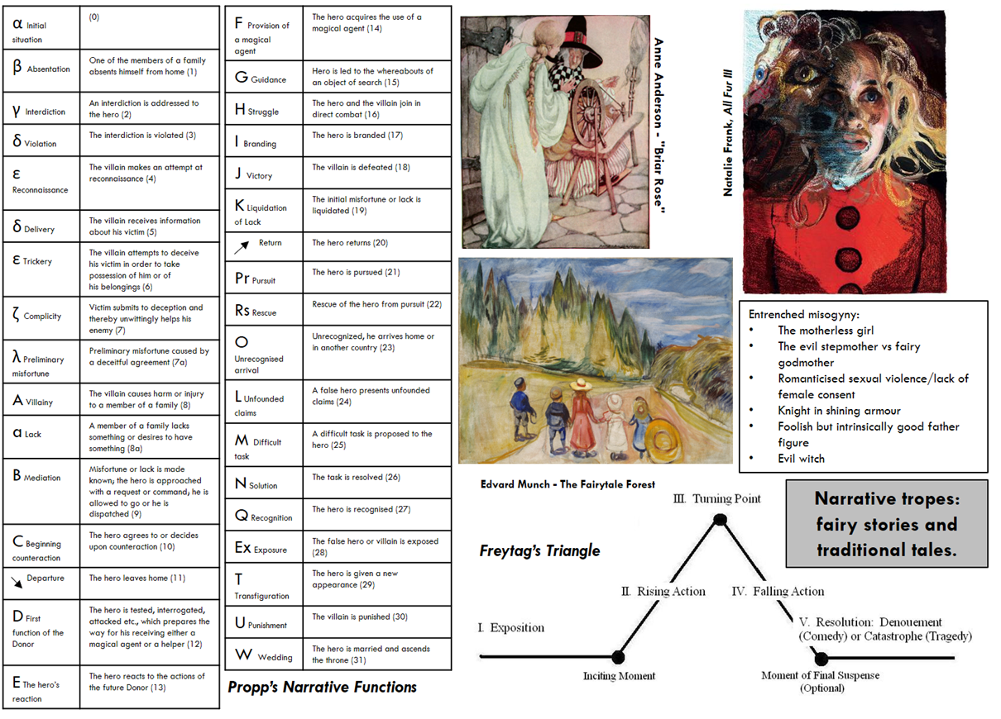
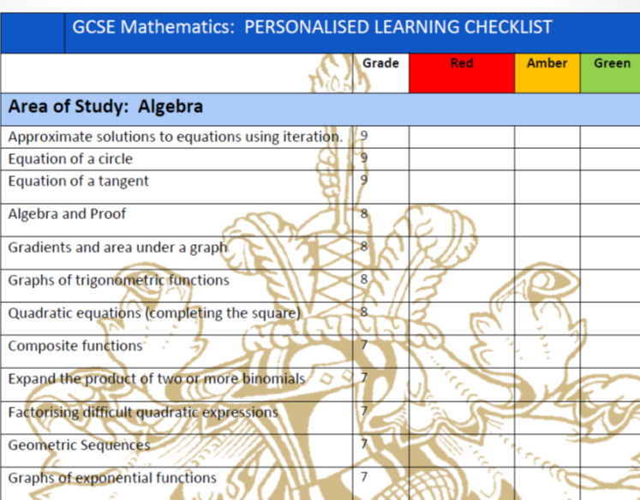
Personalised Check Lists/Knowledge Organisers

Slide 22
How you can help…
They will need you over the next 10 months.
It's easy to forget that when your teenager is rolling their eyes or telling you you're the most embarrassing parent that ever lived and that no-one else's parents make them go to bed before midnight on a Monday… but it’s true.

Slide 23
The next 10 months
Preparing for 100% Examination
English Literature
English Language
Mathematics
RS
History
French
Spanish
Combined Science
Biology, Chemistry & Physics
Computer Science
Geography
Business Studies
PE

Slide 24

The next 10 months
Elements of both controlled assessments and exams.
Health & Social Care
Art
Photography
Textiles
Product Design
Media
Hospitality/Food

Slide 25
Support for you
Student Services
Miss Taylor/Teaching Staff
Gateway App
School Website – Parent Comms.
Helping your child revise events (TBC)
Conversation & Coffee events
Parents Evening- 8th October 2020

Slide 26
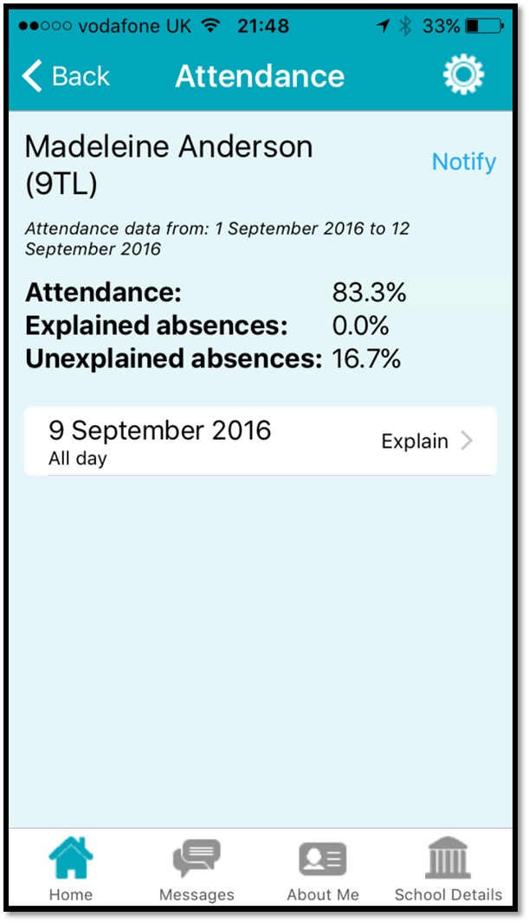
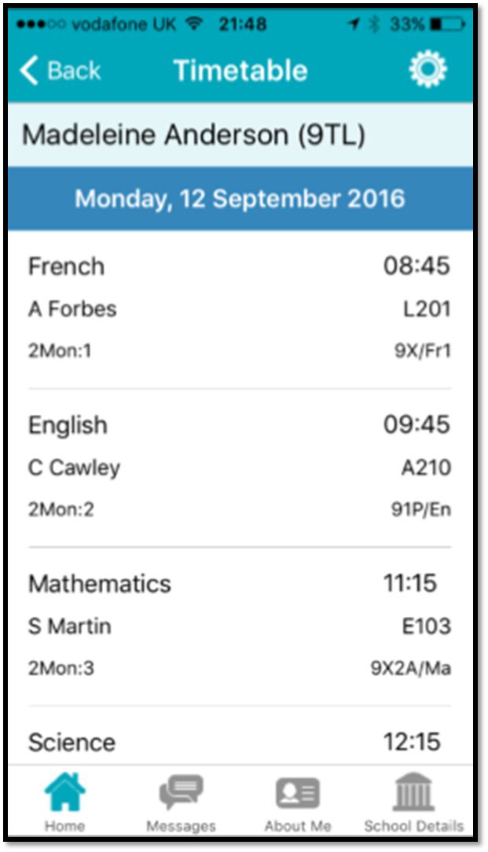
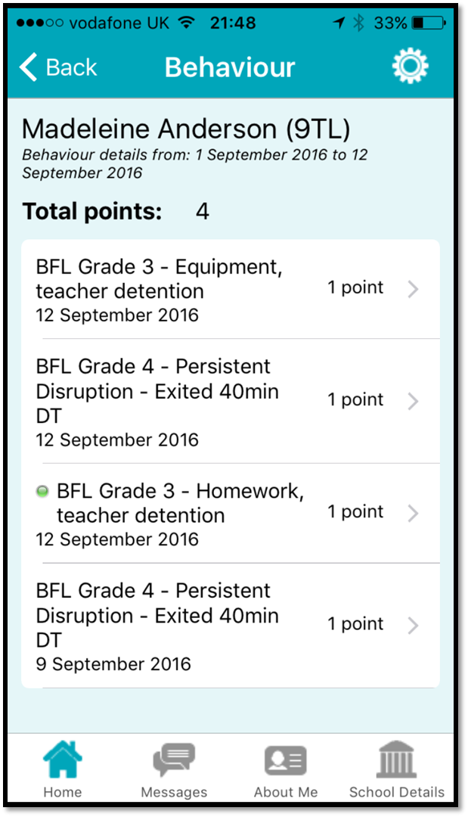
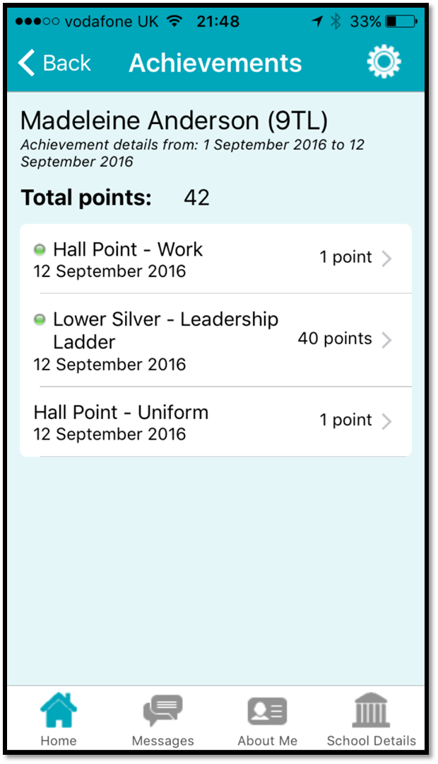
Support for you
Gateway App

Slide 27
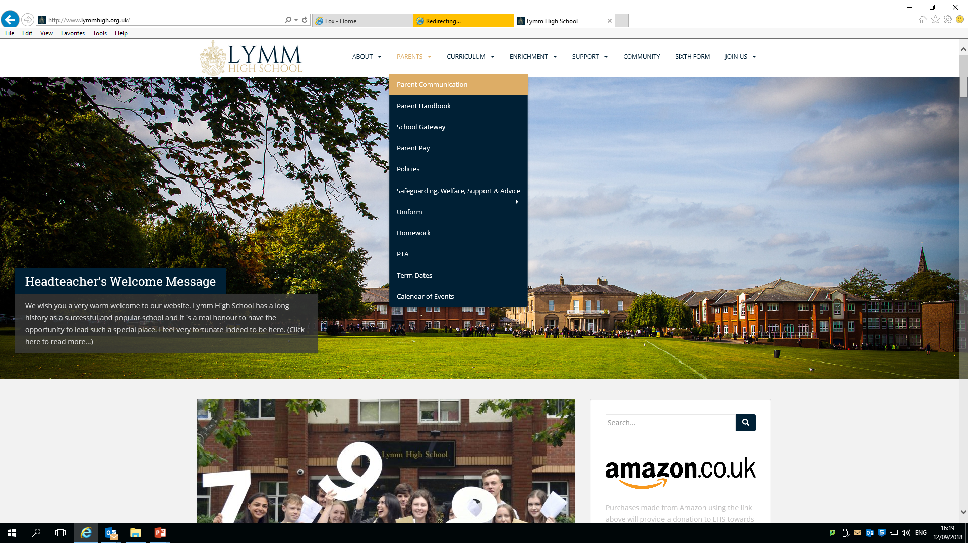
Support for you
School Website – Parent Communication.

Slide 28

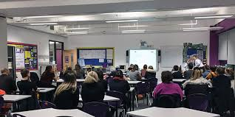


Support for you
Helping your child revise sessions
Parents Evening

Slide 29
Parents evening
Thursday 8th October 2020
1.15pm-7pm (5minute appointment slots)
This will be held virtually via Zoom
Zoom links will be posted on subject ‘Teams’
Please use your child’s zoom account and make the name of your child clear when logging on to help staff
Please alert Miss Taylor/Miss Brown if you have any difficulties in accessing technology for these appointments

Slide 30
Ensuring Success
Punctuality & Attendance
Avoiding distractions
Dress smart/think smart - uniform

Slide 31
Ensuring Success
Punctuality & Attendance
 | > 85% attendance (during 4-week exam period) | < 85% attendance (during 4-week exam period)
Positive P8 score | 77% | 49%
Average P8 | 0.69 | 0.04
Average A8 | 60 | 51
5+ 9-7 grades | 41% | 23%

Slide 32
Ensuring Success
Punctuality & Attendance
 | Approx. hours of lessons missed by end of each half-term
Attendance | Half-term 1 | Half-term 2 | Half-term 3 | Half-term 4 | Half-term 5 | Half-term 6
95% | 10 hrs | 20 hrs | 27 hrs | 35 hrs | 40 hrs | 50 hrs
90% | 17 hrs | 35 hrs | 52 hrs | 67 hrs | 80 hrs | 95 hrs
85% | 25 hrs | 55 hrs | 80 hrs | 100 hrs | 118 hrs | 145 hrs
80% | 33 hrs | 73 hrs | 105 hrs | 135 hrs | 158 hrs | 193 hrs
75% | 40 hrs | 90 hrs | 130 hrs | 168 hrs | 195 hrs | 240 hrs
70% | 50 hrs | 107 hrs | 155 hrs | 200 hrs | 235 hrs | 288 hrs
65% | 58 hrs | 125 hrs | 182 hrs | 235 hrs | 275 hrs | 335 hrs
60% | 65 hrs | 145 hrs | 208 hrs | 268 hrs | 315 hrs | 385 hrs

Slide 33
Avoiding Distractions

Slide 34

Avoiding Distractions

Slide 35
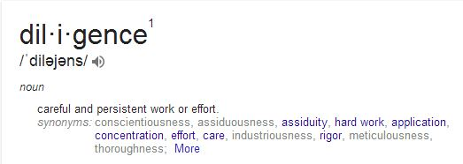
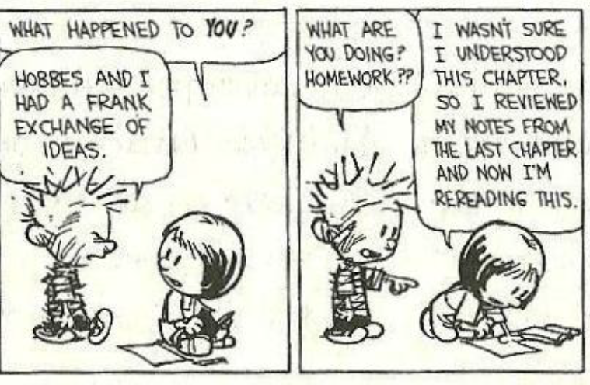
We will be encouraging Diligence

Slide 36

Tests and exams, including GCSEs, can be a challenging part of school life for both children and parents.
But there are ways to ease the stress.

Slide 37
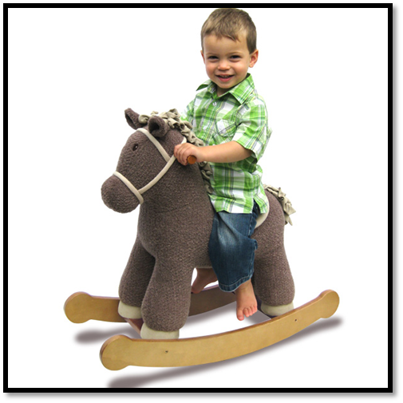
‘Worrying is like a rocking horse it will give you something to do but it will get you nowhere’

Slide 38

“Strive for excellence and success
will follow”
Thank you and have a safe journey home

