Slide 1
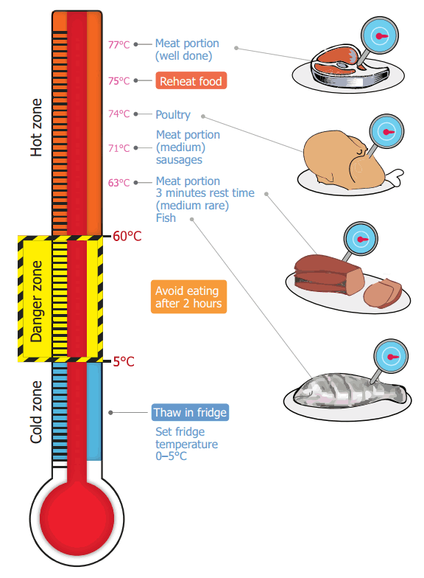
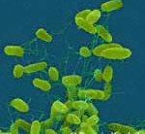
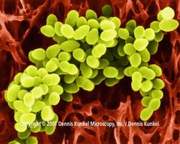

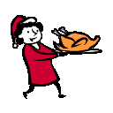
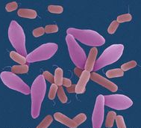


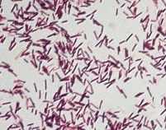

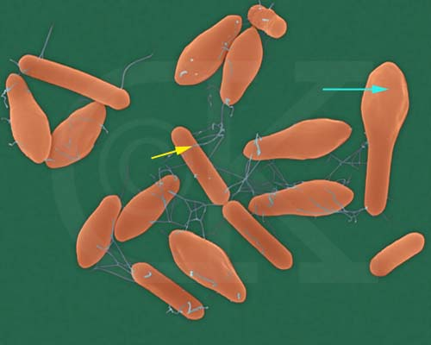
Topic: Food Hygiene
Pathogenic Bacteria | Source | Symptoms | Average Onset Time
Salmonella | Raw meat Poultry and eggs Pests and pets Human and animal intestines Dirt and refuse | Vomiting Nausea Diarrhoea Abdominal pain | 12 - 36 hours after eating
Staphylococcus aureus | Human nose, throat, ears, skin Septic wounds Animals and raw milk | Vomiting Abdominal pain Low temperature | 1 – 7 hours after eating
Clostridium perfingens | Raw meat and poultry Soil, dirt and refuse Raw vegetables Pests and pets Human and animal intestines | Diarrhoea Abdominal pain | 12 - 18 hours after eating
Clostridium botulinum | Soil Marine sediment Raw fish and meat Animal intestines | Paralysis Breathing and swallowing difficulty Diarrhoea followed by constipation | 12 – 36 hours after eating
Bacillus cereus | Dust and soil Cereal, rice and pasta | Nausea Vomiting Abdominal pain Diarrhoea | 1 - 5 hours or 8 –16 hours depending on the form of the food poisoning
Core temperatures:
What is food hygiene?
Food hygiene is about preventing food poisoning. Food poisoning bacteria grow very quickly in food if it is not handled properly, cooked properly or stored properly.
There are laws which control how food manufacturers can prepare and sell food. Statistics show that you are more likely to get food poisoning from a home -made meal than you are from a bought one.
Food poisoning
The illness resulting from eating food or drinking food/drinks containing poisonous substances including bacteria, viruses, pesticides, or toxins.
Usually need millions of bacteria to cause a food poisoning illness.
The multiplication of bacteria within the food plays an important part in the disease
How bacteria grow
In ideal conditions where there is Moisture, Food and Warmth (37degrees centigrade is ideal), bacteria can double every 10 to 20 minutes. They do this by dividing in to two. This is called Binary Fission
In order to grow and multiply germs need:
Time
Moisture
food
Warmth
Food poisoning is more likely to affect people with lowered resistance to disease than healthy people who might show mild symptoms or none at all.
Food poisoning is more likely to affect people with lowered resistance to disease than healthy people who might show mild symptoms or none at all.
Vulnerable people
The following are particularly vulnerable to food poisoning: -
Elderly or sick people
Babies
Young children
Pregnant women
Topic: Food Hygiene
The 4C’s for Good Food Safety
Cooking
Cleaning
Chilling
Cross contamination
High risk foods
These foods tend to be high in protein and are moisture. They can include food like: raw and cooked meat, including poultry such as chicken and turkey, and foods containing these, such as casseroles, curries and lasagne. dairy products, such as custard and dairy-based desserts like custard tarts and cheesecake. eggs and egg products, such as quiche. smallgoods such as hams and salamis.

Slide 2




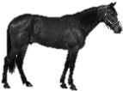


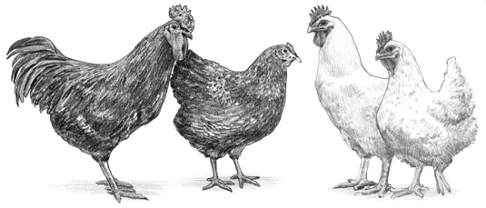
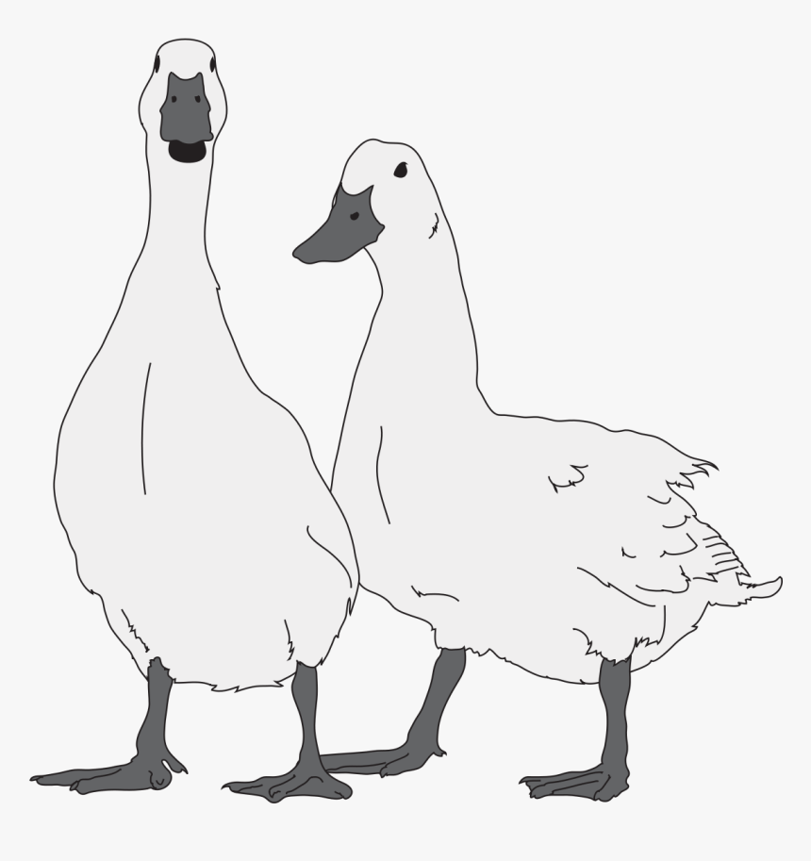
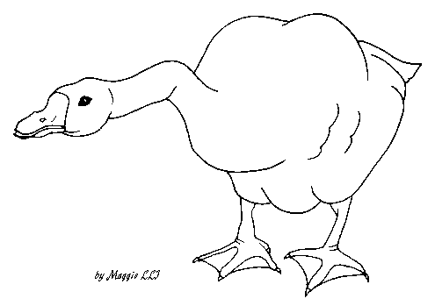
Topic: Commodities - Meat, Poultry, Fish & Eggs
MEAT
Meat is an important food commodity which provides nutrients essential for health.
It is the muscle tissues of dead animals and birds are classified as meat and poultry, whereas the edible internal organs are called Offal. Game refers to wild animals
Sources of meat in the UK include:
Beef |  |  | British reared breeds such as Aberdeen Angus, Longhorn and Hereford have traditionally been considered to provide the best beef in the world.
Organic Beef |  |  | Organic beef and beef from rare breeds, is the most expensive to buy as the highest farming standards will have been needed at all stages of the animal’s life. The length of time for which beef has been hung will also determine how flavoursome and tender it is. 10-14 days is a good length of time. Some super-premium beef is hung for up to six weeks.
Wagu Beef |  |  | Wagu meat comes from a group of Japanese breeds whose meat is renowned for its high level of fat marbling. Western beef has white streaks through it, wagu has more fat than flesh and looks with a splattering of pink. Wagu meat is extremely delicate. The soft fat has a low melting point, due in part to its high proportion of monosaturated fats, to go along with high levels of omega-3 and 6. Fat is where the flavour of meat resides. The taste of wagyu is smooth, velvety and sweet. Many consider it to be the juiciest richest steak in the world.
Veal |  |  | Veal meat comes from the male calves of cows bred for dairy, slaughtered when they are a few months old. For years’ veal has been shunned by British consumers on welfare issue grounds. However, Freedom Food Laws and improved welfare standards for rearing calves have enabled veal to regain its popularity in supermarkets and on restaurant menus in recent years.
Meat from sheep |  |  | Lamb is sheep under one-year-old. Hogget is a lamb older than one year. Mutton is the meat of older sheep.
Meat from Pigs | Pork |  | This is all the meat that comes from pigs. To add extra choice pork can be cured and smoked.
 | Ham |  | This is a specific cut of the thigh part of the pig which has been cured and or salted.
 | Bacon |  | This is produced by curing pork with salt or in brine solution. After maturing it is sold as unsmoked bacon. It can be smoked to add extra flavour to the bacon. The meat is usually darker in colour and has a distinctive flavour.
 | Gammon |  | This is cured whole leg of pork. It is cut into slices and eaten hot as gammon steaks. It could be eaten cold as ham. Some hams may be cured and smoked such as ‘honey roast’. This adds a distinctive flavour and extends the shelf-life of the product.
Topic: Commodities - Meat, Poultry, Fish & Eggs
Other sources of meat can include:
Horsemeat |  | Horsemeat is one of the most controversial meats because for many people the killing of horses for meat is still an emotive subject. The facts remain that it is a healthy meat choice. It has a lower fat content and more omega-3 than to beef. Horsemeat is fairly similar in taste to beef but with a slightly sweeter or subtle game flavour.
Goat |  | Known as Cabrito/Chervon or kid or goat. It is believed that 80% of the world’s population has goat in their diet, it is not as widely popular in the UK. It is typically found in ‘ethnic’ butcher shops, particularly those serving the Caribbean community, where goat is a staple.
Rabbit |  | Rabbit was popular in the UK in the 1940’s and 1950’s when meat was rationed during and after World War 2. It was freely available and if you could catch one. Rabbits were bread especially for meat purposes in homes during the war. The meat is low in fat, cholesterol free, high in protein and tastes similar to chicken.
Venison |  | Venison refers to the meat of a deer. It is classed as game and can either be farmed- reared (methods vary from free range to intensive) or park-reared in herds that roam parklands. Venison is a red meat, similar to beef but leaner and with a slightly richer taste. It is more communally eaten as ‘made-up’ commodities such as sausages, salami, burgers and rissoles.
Poultry |  | Poultry is a very popular food in the UK and is common on restaurant and takeaway menus. Domestic examples include: Chicken, turkey, goose, duck, guinea fowl, poussin (young chicken), quail and ostrich. Game examples include: Partridge, pigeon and pheasant. Poultry is reared in different ways: Indoors in large numbers – a standard chicken is about 40 days old when it is slaughtered Free-range – chickens are allowed outside and reared in large sheds: they are 56 days old when they are slaughtered. Organic – chickens are allowed to roam the fields and are given organic food to eat. They are 80 days old when slaughtered and their meat is usually more expensive to buy. Chicken is the most widely eaten poultry in the world. It has both white and dark meat and has much less fat compared to other poultry. Specialised breeds have been developed for meat (broilers) and eggs (layers)

Slide 3
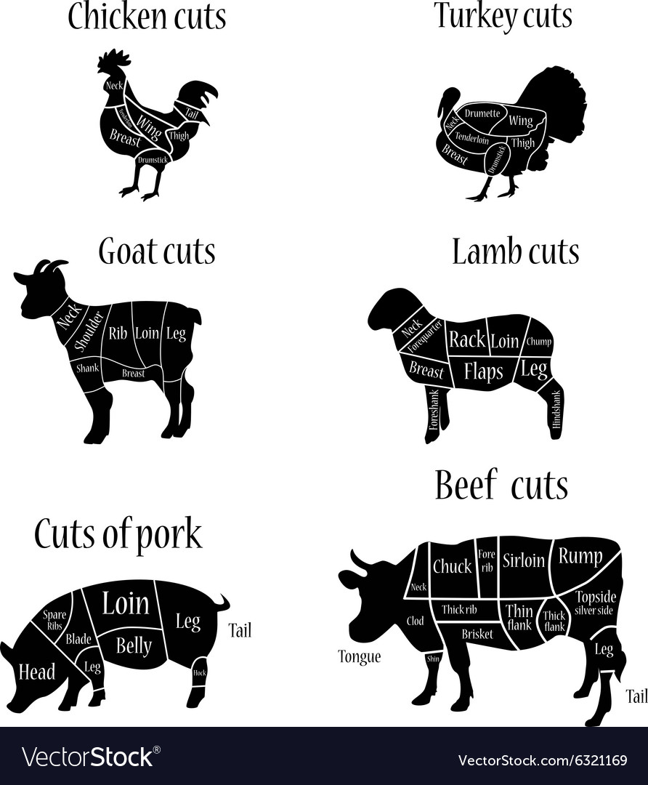
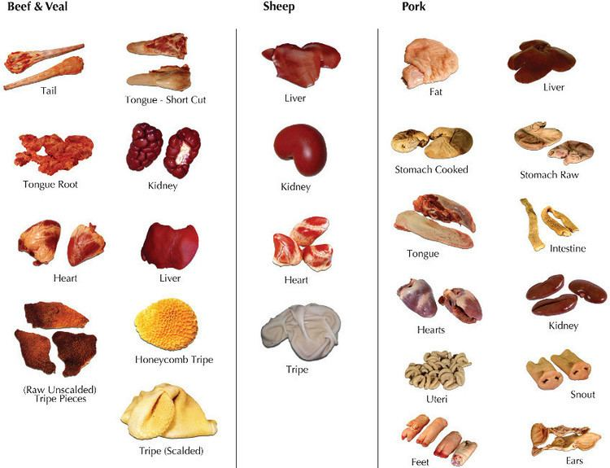
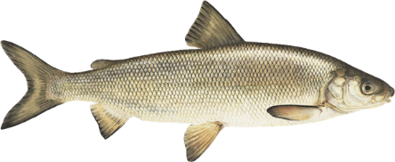
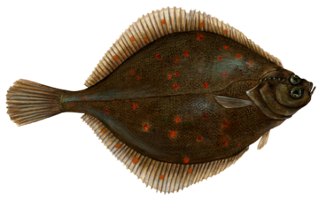
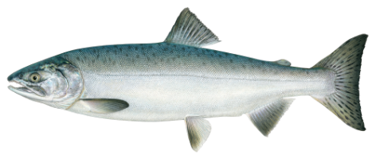
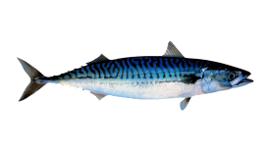
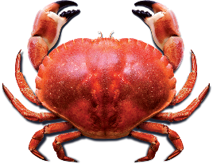
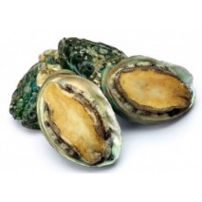
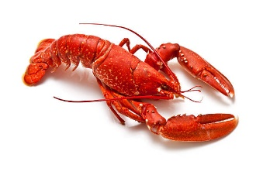
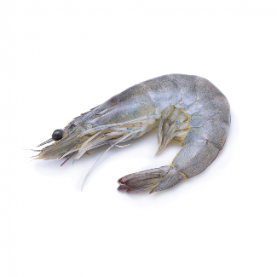
Offal: Meat is the edible internal organs are called Offal.
Know your meat cuts
Topic: Commodities - Meat, Poultry, Fish & Eggs
FISH
Classification | Type | Examples
White | White fish have less than 5 per cent fat (oil) in their flesh, which is why their flesh appears white. Instead, they have oil in their liver. Examples of white fish are: cod, haddock, halibut, whiting, coley, plaice and Dover sole. White fish are round (e.g. cod, haddock and whiting) or flat (e.g. plaice and sole). These have white skin underneath and dark skin on top for camouflage. Most white fish are sea water fish and live on the bottom of the sea bed. This group of fish are known as white fish because of the colour of their flesh—not the skin. Only minute traces of fat are found in this fish flesh.
Oily | have between 10 and 20 per cent fat (oil) in their flesh, which makes their flesh quite dark. Examples of oily fish are mackerel, herring, pilchard, sprat, sardines and salmon. Oily fish that have fat distributed through the flesh in the muscles fibres— (never separate like in meat). They contain—on average 10% fat. They are sea fish such as herring, mackerel, sardines and tuna or fresh water fish such as trout. Or both such as salmon that live in the sea but return to the river to mate and lay eggs.
Shell | Shell fish are found in the sea. Shellfish are divided into: Crustaceans – these have a shell and legs. Examples include prawns, scampi, lobster, and crab. Molluscs – these have a shell but no legs and they often fix themselves to rocks. Examples include cockles, mussels, winkles and oysters. Squid and Octopus - are also classed as molluscs—even though their shell is inside! Fish produced in fresh water include trout and carp

Slide 4
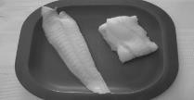
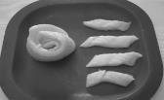
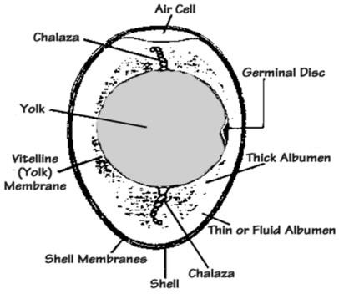
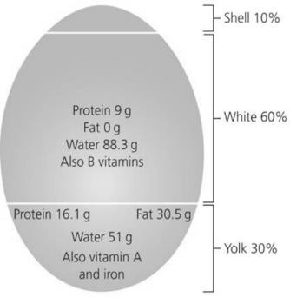
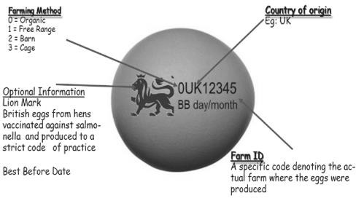
Know your fish cuts
Cuts of fish:
Large fish (e.g. cod, coley, haddock) are cut into fillets, steaks or cutlets. Small and medium fish (e.g. herrings, mackerel, rainbow trout) are usually sold whole and can be filleted by removing the backbone, tail, head and fins. Very small fish (e.g. sprats and whitebait) can be fried and eaten whole.
Ways of preserving fish. Salting - If enough salt is used,
then the fish may keep for up to a year.
Smoking - Fish can be smoked using different techniques. Hot smoked fish are moist, lightly salted and fully cooked. They can be eaten without further cooking. Cold smoked fish are generally saltier in flavour and have less moisture. Cold smoking does not cook the fish. It merely adds a smoked flavour. Smoked fish and salted fish such as kippers and bloaters should have a firm flesh, shiny skin and a good ‘smoky’ smell. Pickling - Pickling fish was originally conceived as a way to preserve it. It is a common technique in Scandinavia.
Pickling is now used widely to
add flavour and sharpness. Canning - Produces a moist, flaky product and makes the bones edible. Oily fish and shellfish such as tuna, salmon, and prawns can be canned in brine, tomato sauce or oil which adds flavour to the fish.
Drying - Fish are laid out to be dried.
Freezing - Packaged in blocks or freeze in water brushing glaze on top.
EGGS
Classification | Type
Organic | These are more expensive as hens have to have access to organic land and eat an organic diet.
Free Range: | The hens are reared in large barns with daytime access to outside runs. There are no feeding guidelines (by products and GM foods to increase productivity and profit margins)
Barn: | The hens are reared in barns with no outside access. They are provided with perches, platforms, nest boxes and litter areas. Areas can be quite crowded with up to 16,000 hens in a barn—depends on the keeper.
Caged; | This makes up approximately 78% of the market. Hens are crammed into a cage so small they can’t stretch their wings. The space they have is about the size of an A4 (this page) piece of paper. They cannot follow their natural behavior patterns. Their bodies suffer through lack of exercise. Birds can lay dead for days before they are taken out of the cage. Debeaking, brittle bones, tumors and pecking are common.
Eggs are an important food commodity which provides nutrients essential for health. Eggs provide a variety of different textures, colours and flavours to dishes. Eggs can be used in a variety of different ways.
The structure of a hen’s egg
The shell: consists of an outer cuticle (a transparent, protective coating, a true shell and inner membranes. The shell is porous (pores are tiny holes), and therefore allows the developing chick to obtain oxygen. At one end of the egg, the membranes separate into an air space, to supply the chick with oxygen.
The air space: increases in size as an egg gets older, because water is lost from the egg and air is drawn in. The fresher the egg, the smaller the air space. This is why fresh eggs sink in water and rotten eggs float.
The yolk: full of goodness (vitamins A, D, E & K) and has a higher concentration of protein than the white.
The white: contains riboflavin and other B vitamins and a small trace of fat
The anchors/chalazae: white strands attached to the thick albumen which anchor the yolk in the middle of the egg.
Size | Weight
SMALL | 53g + under
MEDIUM | 53-63g
LARGE | 63-73g
EXTRA LARGE | 73g+ over
Storing eggs
Eggs should be stored in the fridge or a cool place away from strong smelling foods. Eggs should be stored blunt end upwards. They should be removed an hour or so before use, because cold eggs do not whisk well.
Eggs stay in good condition if stored correctly for two to three weeks. Eggs cannot be frozen whole but the whites and yolks can be frozen separately in containers. Always use eggs by the best before date.
Eggs can be preserved by pickling.
Sizing Eggs
Labelling Eggs
Nutrients in an egg

Slide 5


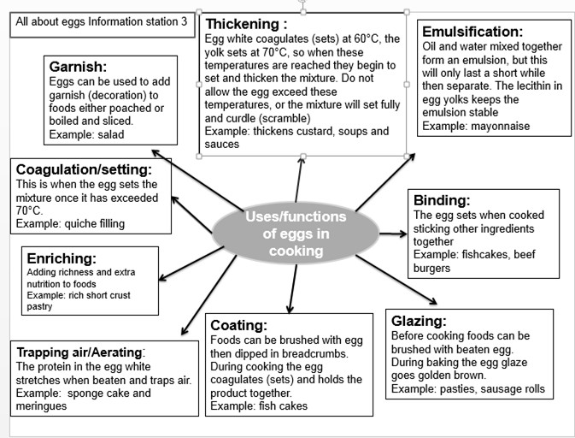
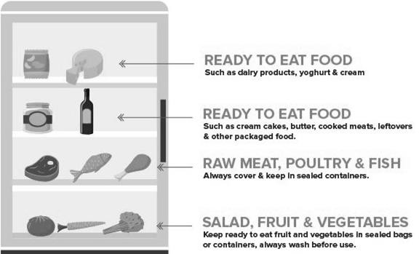
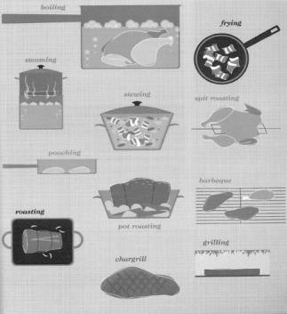
How to grade Eggs
All eggs sold at grocery stores must meet strict standards. Only those of high quality reach the consumer. Eggs must be checked for interior quality by candling, a process where eggs are passed over a strong light to show the shell and interior.
Grade A:
Thick white
Round, well centered yolk
Small air cell (less than 5mm deep)
Clean, un-cracked shell with normal shape
Grade B:
Mostly used for commercial baking or go to hospitals, restaurants, etc. very few are sold at retail stores.
Yolk is slightly flattened; white is thinner
Shell is un-cracked and may have a rough texture; and/or be slightly soiled and stained.
Grade C:
The lowest egg grade, these are used in the production of processed egg products only. They are not sold in retail stores
Yolk is flattened and may be oblong in shape; white is thin and watery.
Shell may be cracked and/or stained
Storing Meat, Poultry and Fish
Should be bought from a
reputable supplier
Should be stored in a leak- proof container
Must be stored at 5’C on the
bottom shelf of a fridge.
Raw meat, poultry and fish must be stored on a shelf below cooked meat, poultry and fish
Must be used as soon as
possible or frozen to use later.
Fish and offal should be used the same day as purchase because they ‘go off’ very quickly.
Raw meat, poultry and fish can cause food poisoning due to incorrect storage, cross- contamination from food handlers not washing their hands and equipment after preparation, and the meat, poultry and fish not being cooked thoroughly.
All raw meat, poultry and fish carry pathogenic bacteria such as Salmonella, Campylobacter and E. coli, with raw chicken being the main source for campylobacter contamination.
EU Law
Under EU law, all meat and poultry for human consumption has to show traceability. Under the law, traceability means the ability to track any food, feed, food-producing animal or substance that will be used for consumption through all stages of production, processing and distribution.
Red Tractor
The Red Tractor
logo gives information on where the food has been farmed, processed and packed. Food given to animals on farms displaying the Red Tractor logo is safe from them to eat with no risk of contamination to the meat or milk produced. The animals’ health and welfare is regularly checked.
Farmers under this scheme must also use responsible farming methods not to pollute land and minimise the impact of their farming methods on wildlife, fauna
and flowers.
RSPCA Assured
Previously Freedom Food, this is the RSPCA’s ethical food label dedicated to animal welfare. The RSPCA Assured label makes it easy to recognise products from animals that have had a better life. It is found on the packaging of meat and dairy products which have met animal welfare
Functions of eggs
Animal Welfare
There are symbols on packaging to show that meat and poultry have met welfare standards. Animal welfare refers to the well- being of animals and covers areas such as the animals’ access to fresh water and a diet to maintain full health. It also gives assurance that animals are reared free of any discomfort, pain, injury or disease, and are provided with adequate shelter and a comfortable resting area.
Storing Meat, Fish & Eggs
Cooking methods for Meat, Fish & Eggs

Slide 6
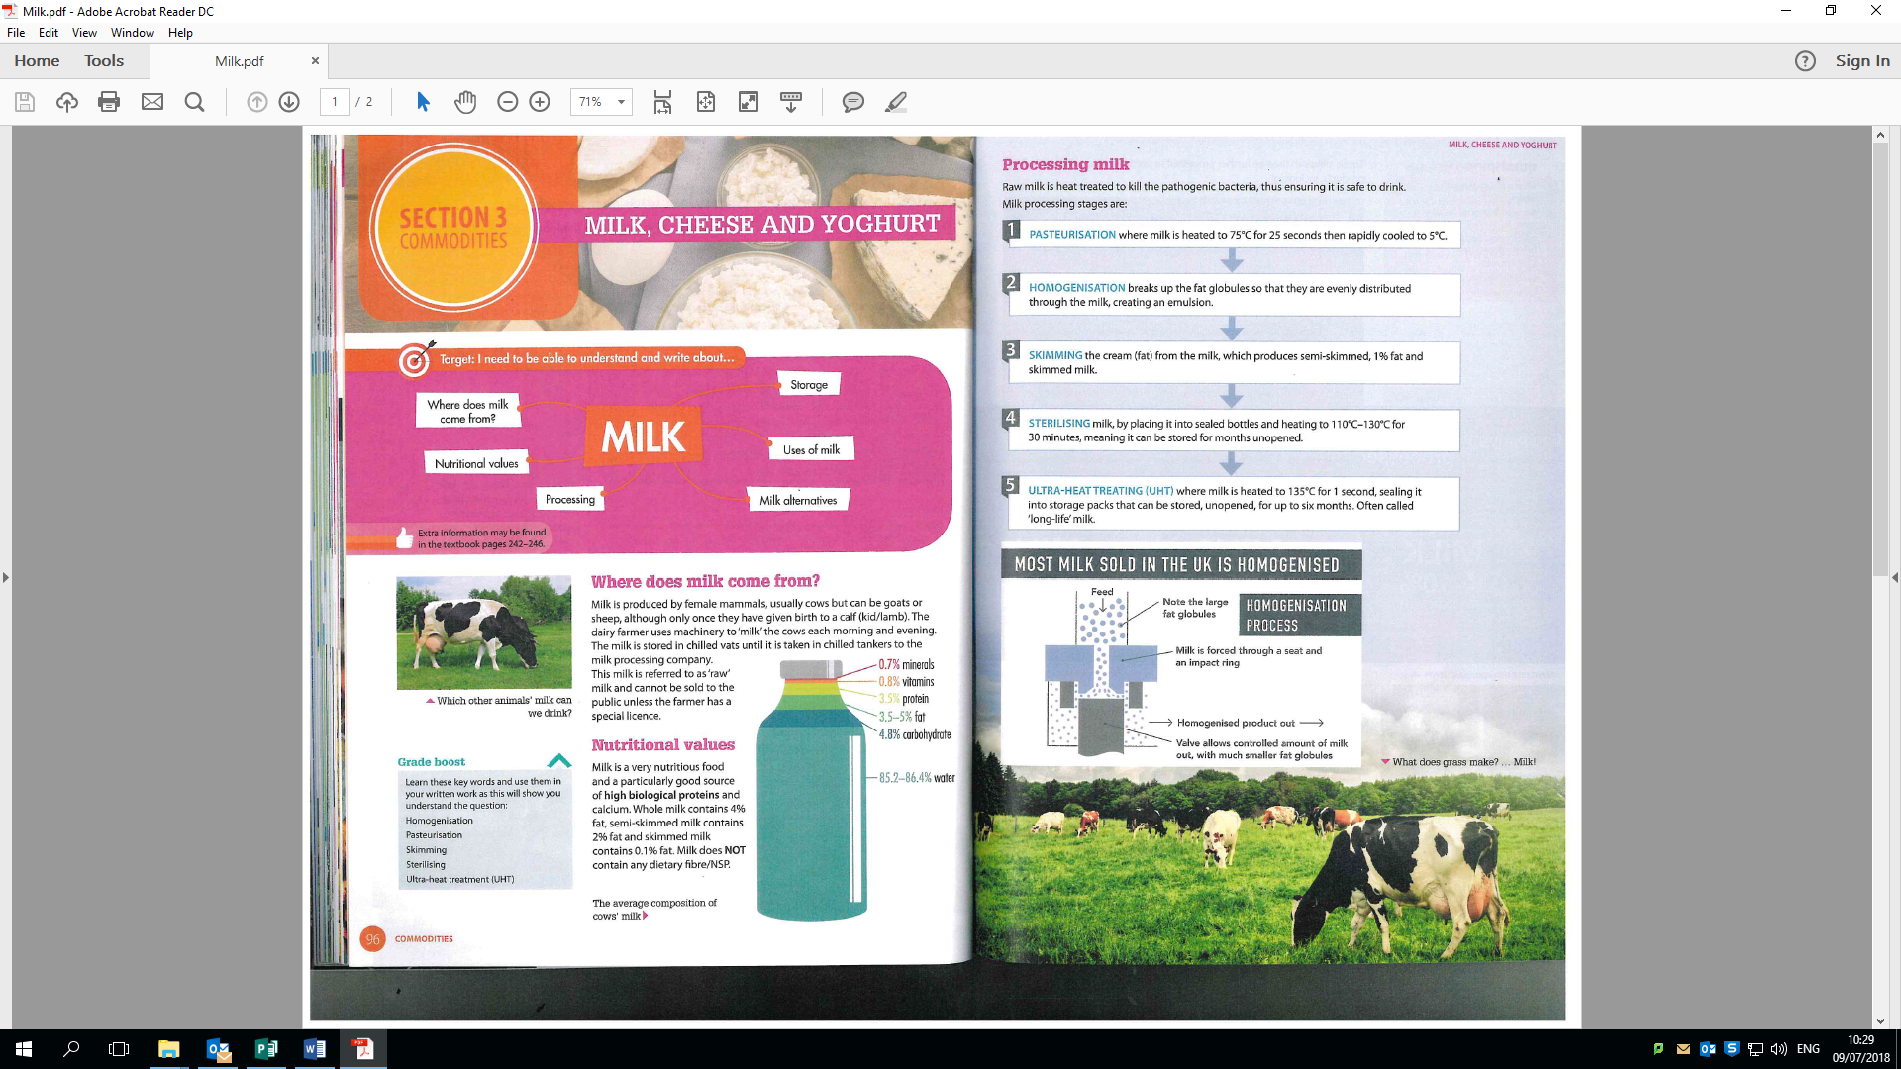
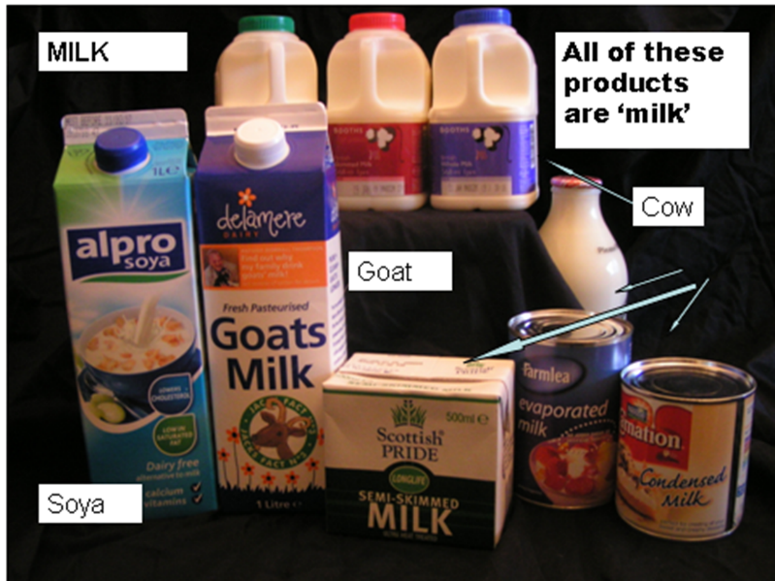

Topic: Commodities – Milk and Dairy Produce
Where does Milk come from? Milk can come from, a cow, a goat, a sheep and even a horse. Milk can also be made from soya beans, rice and wheat.
Ways to preserve milk - Heat treatments Pasteurised
A mild heat treatment.
It only kills pathogenic bacteria to make it safe to drink.
It extends the shelf life.
It needs to be kept chilled.
There is no change in flavour or nutritional value.
The fat (cream) rises to the top.
UHT or Long life
Milk is sterilised—heated to 100°C for 20 minutes to kill all bacteria. It also destroys the B vitamins. Milk is homogenised. Milk is packaged using aseptic packaging.
Evaporated Milk
Evaporated milk is a concentrated, sterilised milk product. It has a concentration twice that of standard milk. The process of producing evaporated milk involves standardising, heat treating and evaporating the milk under reduced pressure, at temperatures between 60ºC and 65ºC. It is then homogenised and cooled. The evaporated milk is poured into cans, which are then sealed. At this point the cans are moved to a steriliser where they are held for 10 minutes. A cooling stage follows and the cans are then labelled and packed.
Condensed Milk
Condensed milk is concentrated in the same way as evaporated milk, but with the addition of sugar. It is not sterlised but is preserved by the high concentration of sugar. It can be made from whole milk, semi skimmed or skimmed milk. The heat treatment used consists of holding standardised milk at a temperature of 110- 115ºC for one to two minutes. The milk is then homogenised, the sugar added and the sweetened milk is then evaporated at low temperatures (between 55-60ºC). The concentration of the condensed milk is now up to 3 times that of the original milk. The milk is then cooled rapidly to 30ºC and packaged. Sweetened condensed milk is commonly used in the sugar
Dried Milk Powder
Milk powder is produced by evaporating the water from the milk using heat. The milk is homogenised, heat treated
Skimmed milk powder can be mixed easily with water; however whole milk isn’t easily reconstituted due to its
Milk is an important food commodity which provides nutrients essential for health. Milk is considered nature’s most perfect food. A variety of different foods can be made from milk.
Milk is a pale liquid produced by the mammary glands of mammals. It is the primary source of nutrition for infant mammals (including humans who breastfeed)
Types of Milk | Description
Whole milk | Milk with nothing added or removed. Fat content: 3.9%.
Semi-skimmed milk | The most popular type of milk in the UK. Fat content: 1.5%
Skimmed milk | Milk that has had most of the fat removed. Fat content: 0–0.5% (average 0.1%)
1% fat milk | Offered to consumers who like the taste of semi-skimmed, but want milk with a lower fat content.
Organic milk | Milk from cows that have been grazed on pasture that has no chemical fertilisers, pesticides or agrochemicals used on it.
UHT milk | Milk that has been heat treated to give it a longer shelf life. Once opened it must be treated in the same way as fresh milk.
Lacto-free milk | Milk that has had the milk sugar (lactose) removed, making it suitable for those who have an intolerance to lactose.
Soya milk | Made from the liquid of cooked soya beans. It is suitable for vegans and substitute milk for those who are allergic to dairy food.
Goat’s milk | Another substitute milk for people allergic to cow’s milk.
Evaporated milk | A concentrated, sterilised milk product. It has a concentration twice that of standard milk. Evaporated milk is heat treated and then evaporated under reduced pressure, at temperatures between 60ºC and 65ºC The evaporated milk is poured into cans, which are then sealed. At this point the cans are moved to a steriliser where they are held for 10 minutes.
Condensed milk | Concentrated in the same way as evaporated milk, but with the addition of sugar.
Dried milk powder | Produced by evaporating the water content of milk using heat.
Almond and coconut milk | An alternative for vegans or people with allergies
How milk is used:
As a drink on its own or flavoured – for its nutritional content.
Added to cereal to improve the nutritional content, it
changes the texture
As an essential ingredient in batter, sauces and custards—it allows Gelatinisation., combining with egg to coagulate into a soft product.
In baked products such as cakes, biscuits and bread, providing moisture to help them rise and produces a soft texture as it stops starch and fat clumping together.
The fat is separated from the rest of the milk to make
cream
When acid is added it curdles and becomes solid or
semi-solid, making cheese
Cream is churned (moved around quickly—beaten) to make butter
Yoghurt is fermented milk. A bacteria culture is added.
This breaks down the protein and makes it coagulate
Red tractor scheme
The Red Tractor symbol on packaging helps consumers know that the milk and dairy foods have been produced according to the high standards of the Assured Dairy Farms scheme. This has been developed by dairy farmers, processors, the National Farmers Union and the British Cattle Veterinary Association.
1/3 water
1/3 Protein
1/3 Fat

Slide 7
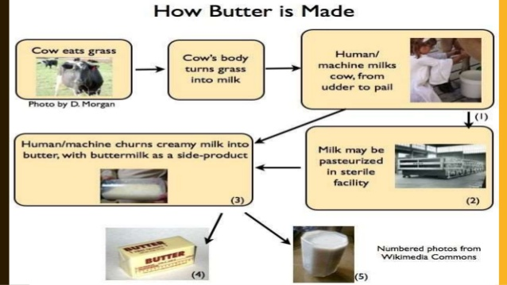
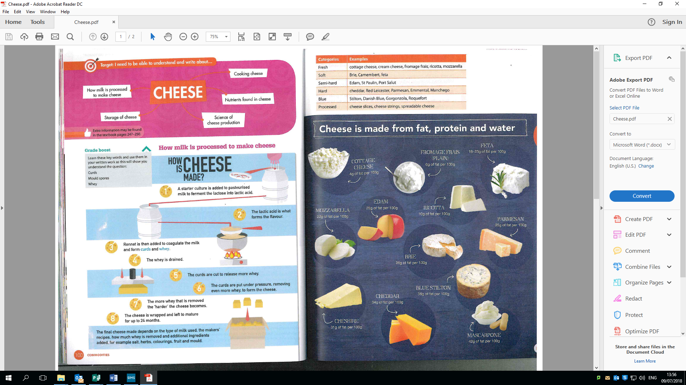
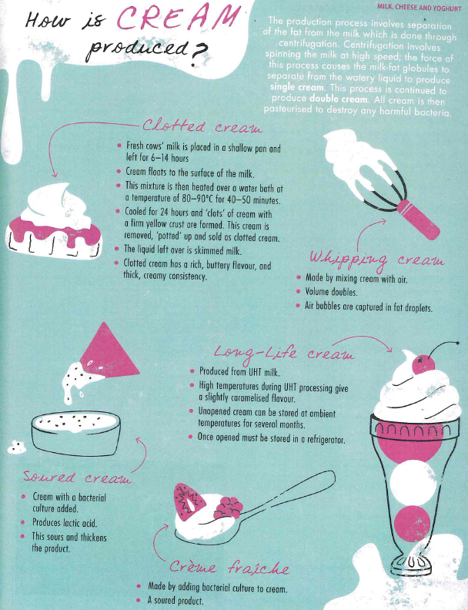
Topic: Commodities – Milk and Dairy Produce
Butter is made from the fat found in the cream.
How should cream be stored:
All fresh cream must be stored in a refrigerator at 5’C. sterilised/long life/ UHT cream has a long shelf life and can be stored, unopened, in a kitchen cupboard. However once opened this cream must be treated the same as fresh cream.
Cheese can be described as a solid or semi-solid form of milk. It is sometimes referred to as a fermented dairy food. It is made from cows’, ewes’, goats’ or buffalo milk.
Yoghurt is made from milk. It is made by adding harmless edible bacteria to the milk, which causes it to ferment. This means the carbohydrate (sugar) in the milk, which is lactose, is converted into lactic acid by the bacteria. The lactic acid will set the milk’s protein, which will thicken it. The lactic acid will also give the yoghurt its characteristically tangy flavour.
Different yoghurts can be made from different types of milk. Some yoghurt will include additional ingredients such as sugar, which is used to sweeten it (e.g. fruit and other flavours such as honey or vanilla).
Examples of types of yoghurt:
Set yoghurt: is set in the pot in which it is sold. Has a firmer texture than other yoghurts. Live yoghurt: this has been fermented with live culture bacteria that are still living. Greek (strained) yoghurt: made from cows’ or ewes’ milk. It can be quite a thick yoghurt and is higher in fat.
Nutritive value of yoghurt:Yoghurt will provide the following nutrients:
Protein,Fat Calcium ,Carbohydrates, Vitamins, Water
Storage of yoghurt - Store in the refrigerator between 1 and 5°C. Use before the use-by date.
Uses of Cheese
Cheese can:
provide flavour (e.g. when making a white sauce adding cheese gives improved flavour)
be used to make both sweet and savory dishes.
provide colour (e.g. when sprinkled on top of dishes and grilled or baked it will turn an attractive brown colour)
provide texture (e.g. when melted in can provide a soft, moist and stringy texture)
increase the nutritional value of a dish (e.g. when sprinkled on top of a baked potato, it will provide additional nutrients such as protein, fat, calcium and vitamins).
Soft cheeses have the most moisture
Some soft cheeses are left to ripen such as Brie and Camembert
Cottage cheese has a bacteria added to it that makes it clump together in lumps
Ricotta is a soft whey cheese - low in fat
Moulds grow on the outside and help to soften the curds inside
Cream is derived from the fat found in all fresh milk. Cream is the concentrated fat, which has been skimmed from the top of milk.
Cream has a high fat content ranging from 18-55% fat depending on the production process used. The levels of saturated fat in cream are the reason why it should really not be eaten too frequently because of its links with coronary heart disease and raise cholesterol levels. The different types of cream available in the UK are legally defined by the percentage of fat that they contain.
Types of cream: Single cream, Double cream, Whipping cream, Clotted cream, Ultra heat treated (UHT) cream
Cream is used to add a creamy texture and flavour to dishes. The correct cream must be used for specific tasks because different types of cream have different properties – for instance single and clotted creams cannot be whisked for pipping whereas whipping and double cream will aerate when whisked.
Cream is used to add a creamy texture and flavour to dishes. The correct cream must be used for specific tasks because different types of cream have different properties – for instance single and clotted creams cannot be whisked for pipping whereas whipping and double cream will aerate when whisked.
Semi- hard cheeses are ‘pressed’ cheeses - but not pressed as much as hard cheeses! are examples
Lancashire, Wensleydale, Caerphilly, Edam, Gouda
Port Salut, St Paulin
Feta cheese is preserved in a brine solution
Mozzarella is a cheese that is cooked during its process. This gives it its stringy texture
Hard cheeses have the least moisture. Examples are:
Cheddar, Leicester, Double Gloucester, Cheshire
Gruyère, Emmental, Parmesan, Parmesan is the hardest cheese of all!

Slide 8
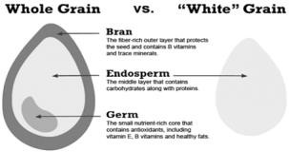
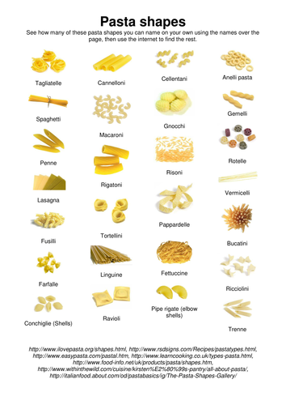
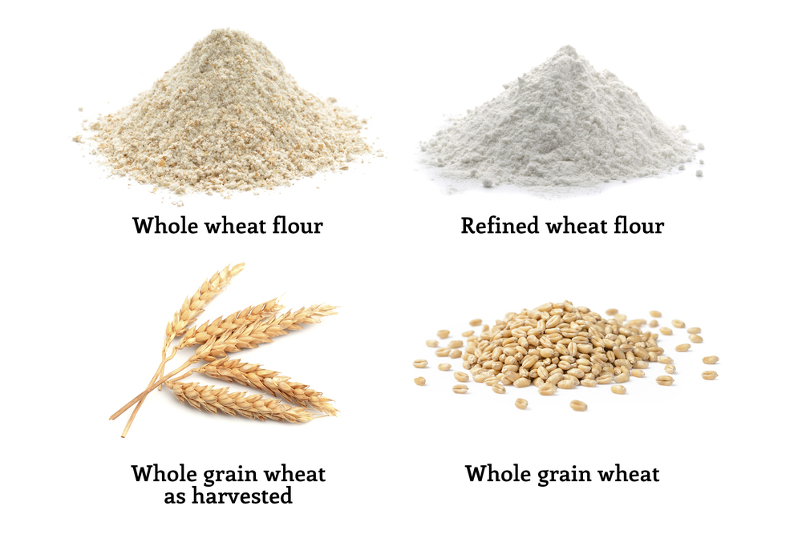
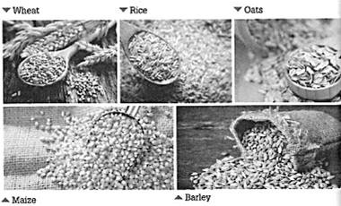
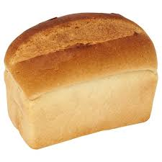
Commodities: Cereals, Fruit & Vegetables
How cereals are processed:
Processing the flour after milling
After the milling process, different grades of flour are produced by sifting, separating and regrinding the flour several times. These grades are combined as needed to produce different types of flour.
Small amounts of bleaching agents (to make the flour white) and oxidizing agents (to enhance the baking quality of the flour) are usually added to the flour after milling.
Nutrients calcium, iron and B group vitamins are added to. This is called fortification. Baking powder will be added to make self-raising flour.
Flour:Flour comes from different types of cereals,
e.g. rye and wheat.
Wheat flour is one of the main flours produced. There are different strengths of wheat flour depending on its uses:
Strong flour is used in bread making and comes from winter wheat, which is a hard
Wholemeal flour is made from the whole wheat grain, nothing is added or taken away. It is referred to as having 100% extraction rate. It is a good source of dietary fibre.
Brown flour usually contains about 85% of the original grain. Some bran and germ have been removed.
White flour usually contains around 70-72% of the wheat grain. Most of the bran and wheat germ have been removed during the milling process.
Granary flour is made by adding malted wheat (which has been toasted and flaked), to any type of flour but usually it is added to wholemeal or brown flour.
Stoneground flour is wholemeal flour ground in a traditional way between two stones.
Organic flour is made from grain that has
Pasta is made from strong wheat known as durum wheat.
This type of wheat contains more protein than common wheat.
During the milling process the wheat produces semolina.
This is the coarsest grade of the starchy endosperm.
To make pasta, water is added to form a dough, which can be shaped or extruded (forced though an opening in a shaped plate and then cut to a specific size) to produce the type of pasta required.
Other ingredients that can be added during the making of the pasta dough include eggs, oil, salt and various flavourings.
Different shapes, sizes and styles of pasta are widely available to buy in shops. Various colours of pasta re alos sold:
Green pasta is made using spinach, which provides the colour as well as some flavour. Red pasta is made using tomato paste. Squid ink pasta or black pasta is dark grey, almost black in colour and is made using, as the name suggests, squid ink. This can sometimes give the pasta a mild seafood flavour.
Dried pasta is popular due to its long shelf life and versatility. It can be combined with many other ingredients.
Fresh pasta must be stored in a refrigerator. Fresh and homemade pasta can be frozen
Homemade pasta must be allowed to dry and then stored in an airtight container in the refrigerator.
Cooked pasta should be stored in an airtight container in the refrigerator. Rinsing with cold water after cooking will stop it sticking together.
A ‘wholegrain’ is made up of three elements:
a fibre-rich outer layer – the bran
a nutrient-packed inner part – the germ
a central starchy part – the endosperm.
Cereals provide a valuable source on energy in the diet, as well as other nutrients if the wholegrain is used. These include: Fibre, Protein, Carbohydrates, Vitamin E, B vitamins, Fat, Iron.
Cereals provide a valuable source of energy in the diet, as well as other nutrients if the wholegrain is used. These include: Fibre, Protein, Carbohydrates, Vitamin E, B vitamins, Fat, Iron
Bread is a staple food in much of the world. It is made from strong flour, yeast, salt and water. Fat is often added to extend the shelf life of bread. Sugar is added for sweetness and to add colour.

Slide 9
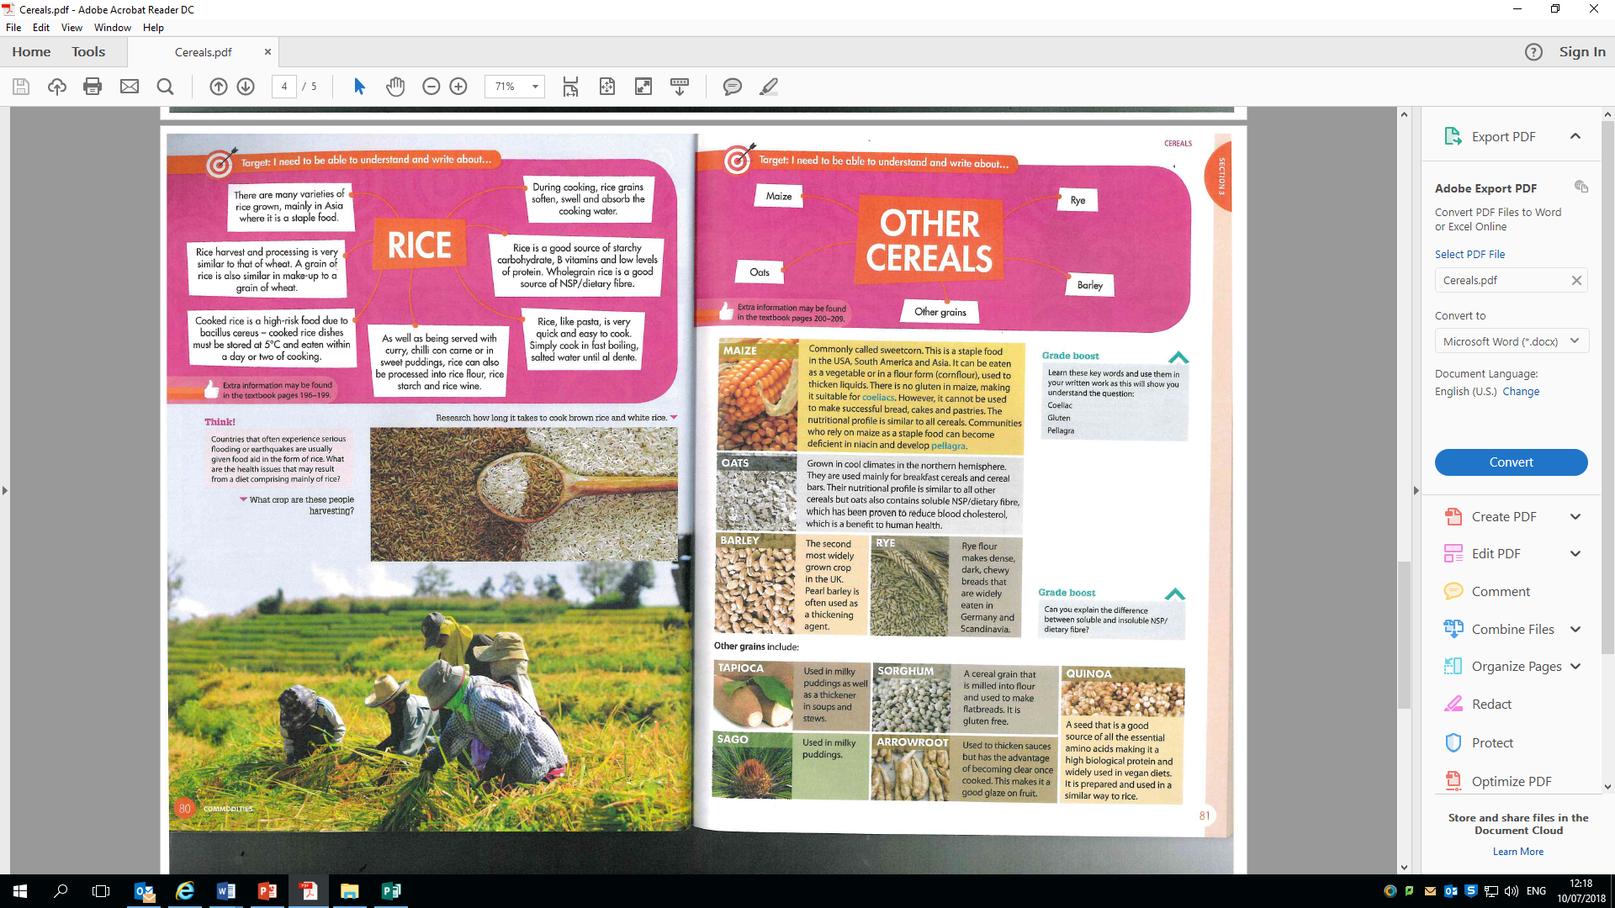
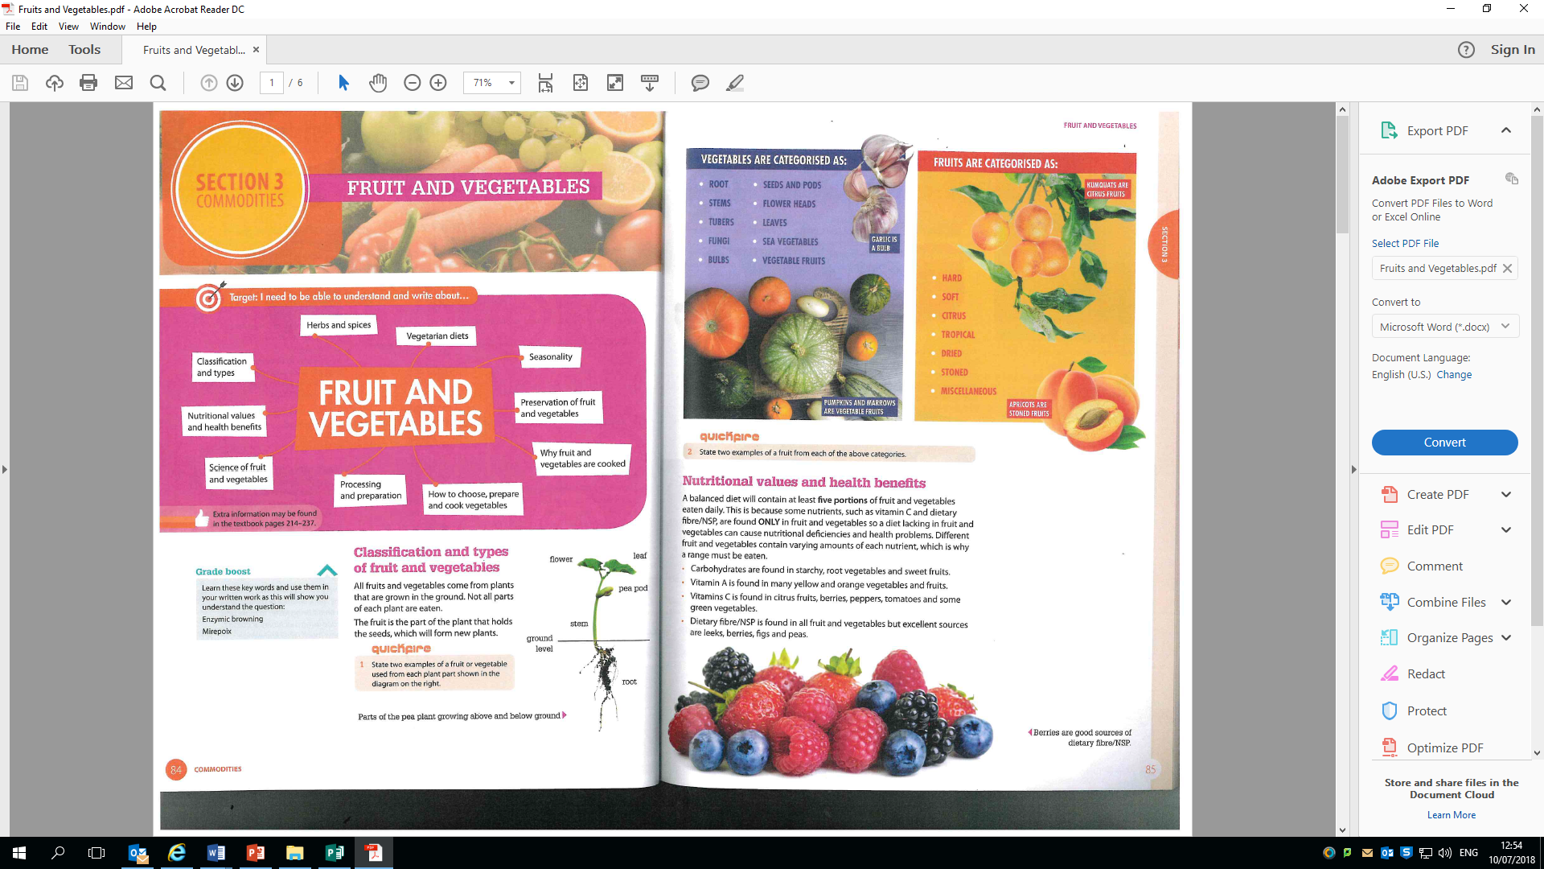
Commodities: Cereals, Fruit & Vegetables
Cooking methods for potatoes:
The variety of the potato used when preparing meals and dishes can result in a variety of different textures and outcomes.
Cooked potatoes can be floury, sticky or waxy and granular: this is due to the potato cell changing during the cooking process.
All different varieties of potatoes have the same structure: Outer layer is the skin.
The flesh is the area under the skin.
The pith is the watery core, the innermost part.
Potatoes are regarded as a traditional staple food. In the UK, they are often eaten as the main accompaniment to dishes.
They can be prepared and cooked in a variety of ways: Baked, Roasted, Fried, Boiled Steamed
Storage of potatoes
Potatoes can be stored in hessian bags, paper bags or in racks. They should be stored in a cool, dry, dark, airy place.
Storing potatoes in a light environment can cause them to turn green. This should be removed before cooking as the green part is toxic.Potatoes should not be stored in plastic bags as this can cause them to sweat and rot.
Storing potatoes in a refrigerator can affect the taste and cause discolouration when they are cooked.
Rice is one of the most popular staple foods eaten by the world’s population.
It is a very versatile commodity because it can be used to make both sweet and savour dishes
Rice is served as part of a meal to provide bulk and a feeling of fullness.
It is quick to cook
It is a good store cupboard ingredient as it has a long shelf life and is easy to store.
Rice can be quite bland in flavour. This can be improved by cooking it with flavoursome ingredients such as garlic and herbs, or by cooking the rice in stock instead of water.
Cooking rice
You can cook rice using different cooking methods: Boiling on the hob, Baking in the oven Stir-frying once cooked, Cooked in a rice cooker
Nutrition
Rice is regarded as the poorest of all cereal foods in relation to its protein, fat and mineral content, but is an excellent source of energy.
Varieties of rice:
There are many different varieties of rice available in supermarkets and it is sold in a variety of different forms, for example boil-in-the-bag, easy cook and pre-cooked.
Rice can be short grain or long grain and most types are available as brown or white rice.
Harvesting rice;
When rice is harvested the grains are covered in a thick outer husk. This is removed during processing.
Storage
To store uncooked rice:
Store in a cool, dry area.
Once opened store in an airtight container
It is recommended that cooked rice should not be stored and reheated as this can lead to food poisoning.
Once cooked, rice becomes a high risk food. If it is necessary to store cooked rice
Store above 65’C for no longer than two hours.
Rinse in cold water immediately after cooking, chill and refrigerate.
All fruits and vegetables come from plants that are grown in the ground.
Not all of each plant is eaten.
Fruits are the part of the plant that holds the seeds, which will form new plants.
Potatoes
The part of the potato plant we eat is called the tuber. There are many different varieties of potatoes grown in the UK. Some examples of these include: Maris Piper, King Edward, Desiree. Sweet potatoes are also a popular choice as an alternative to traditional potatoes. Potato tubers can come in a variety of colours; we are most familiar with red and white potatoes. When we make a choice between a red or white potato it is often related to the taste and the type of recipe being prepared.

Slide 10
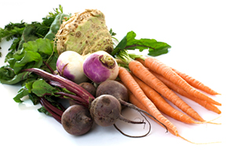
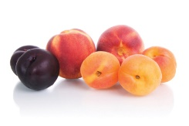
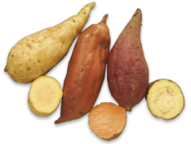
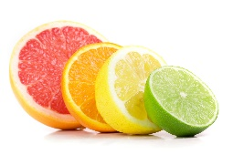
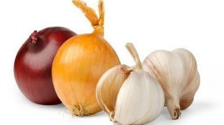
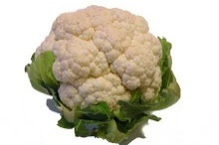
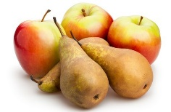
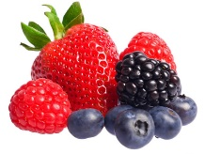
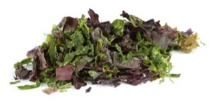












Commodities: Cereals, Fruit & Vegetables
Organically produced
All fruit and vegetables can be organically produced, that is grown using natural fertilizers and pesticide. They can also be locally sourced. each plant is eaten.
Root | These include beetroot, carrots, celeriac, parsnips, radishes, swede, turnips, cassava, galangal
Tubers | These include potato, sweet potato, Jerusalem artichokes
Bulbs | These include onions, leeks, shallots, garlic, fennel
Flower heads | These include broccoli, cauliflower, brassica, Brussels sprouts, cabbage, kale, Chinese cabbage, pak choi
Sea vegetables | These include kelp, nori, samphire, agar-agar
Stems | These include asparagus, celery, rhubarb, chicory, globe artichokes, kohlrabi, sea kale, endives
Fungi | These include mushrooms (chestnut, chanterelle, shiitake, oyster, morels, ceps, portabello, open)
Seeds and Pods | These include beans, peas, lentils, runner beans, bean sprouts, okra, sweetcorn, sugar snap peas, mange tout
Leaves | These include cabbage, Brussels sprouts, lettuce, spinach, watercress, pak choi, kale
Vegetable fruits | These include aubergines, tomatoes, courgettes, marrow, peppers, pumpkin, squash, avocado, cucumber
Stoned | These include apricots, cherries, damsons, greengages, nectarines, peaches, plum
Citrus | These include clementines. Grapefruit, kumquats, lemons, limes, mandarins, pomelo, oranges, tangerines
Hard | These include apples, pears, quince
Soft berry | These include blackberries, blueberries, bilberries, cranberries, gooseberries, raspberries, strawberries
Dried fruit | These include banana, pineapple, prunes, figs, raisins, currants, sultanas, apricots
Tropical | These include acerola, cape gooseberries, jack fruit, avocado, water melon, guava, dragon fruit, lychee, mango, passion fruit, tamarind, coconut
Miscellaneous | These include banana, dates, passion fruit, figs, grapes, guavas, kiwi fruit, mangoes, melons, lychees, Sharon fruit, pineapple, pomegranate
Nuts | These include Brazil, cashew, peanut, almond, walnut, hazelnut, pecan, pistachio macadamia.
Nutrition
Fruits and vegetables contain Carbohydrates in the form of starch and sugars in fruits. Vitamins A, C & D. Minerals and dietary fibre which is mainly found in the skins of fruit and vegetables.
Buying fruit and vegetables
Always choose fruit and vegetables that are ‘fresh’ looking with a good colour, no blemishes, bruises, wilting or damage.
Storing fruit and vegetables
Fresh fruit and vegetables quickly spoil and decay. Store in cool dark spaces. Rinse fruit and vegetables before use. Do not soak. Peel thinly to preserve nutrients found just under skins. Do not prepare green, leafy vegetables too far in advance as they loose vital nutrients
Uses of fruit and vegetables
Fresh fruit and vegetables can be dried, canned and bottled. Be frozen, MAP-bags of salad leaves and fruit and UHT cartons of juice
Cooking fruit and vegetables
They are cooked to: soften textures to make them easier to eat. Improve the flavours. Makes them more digestible, reduces bulk

